Slide 1
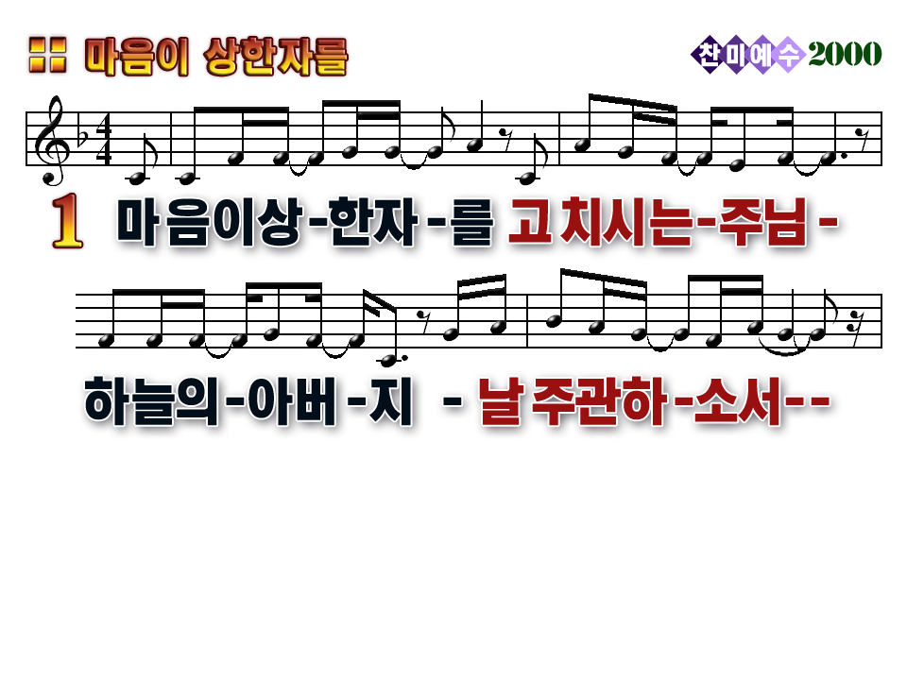

You bind the broken hearted
You heal the wounded soul
Father of all heaven
We give You full control
1
2

Slide 2
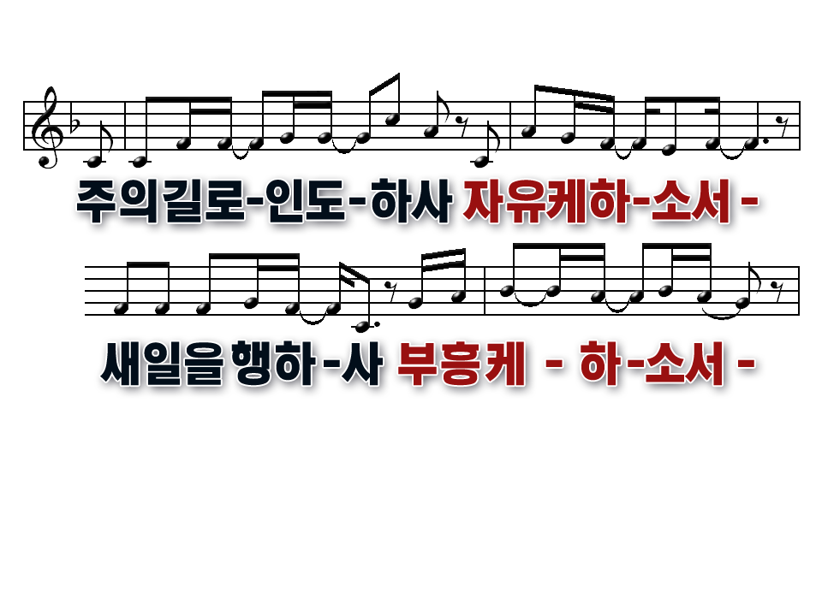
Come have Your way in us, O Lord
Come set our spirits free
O Father send revival
And start the work in me
1
2

Slide 3
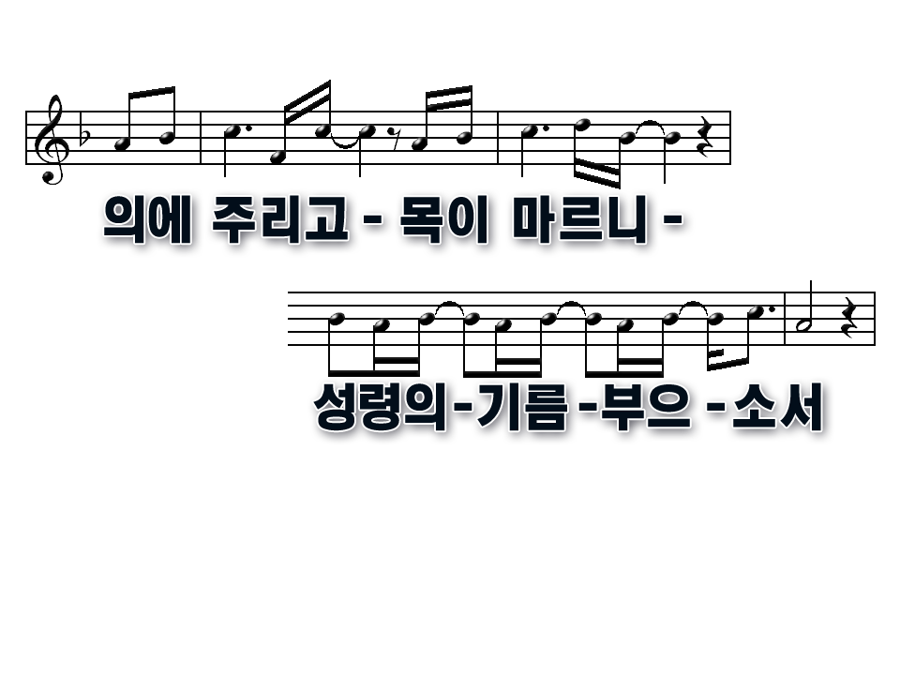
Lord, I hunger, thirst for Your righteousness
Father come and fill me once again
1
2

Slide 4
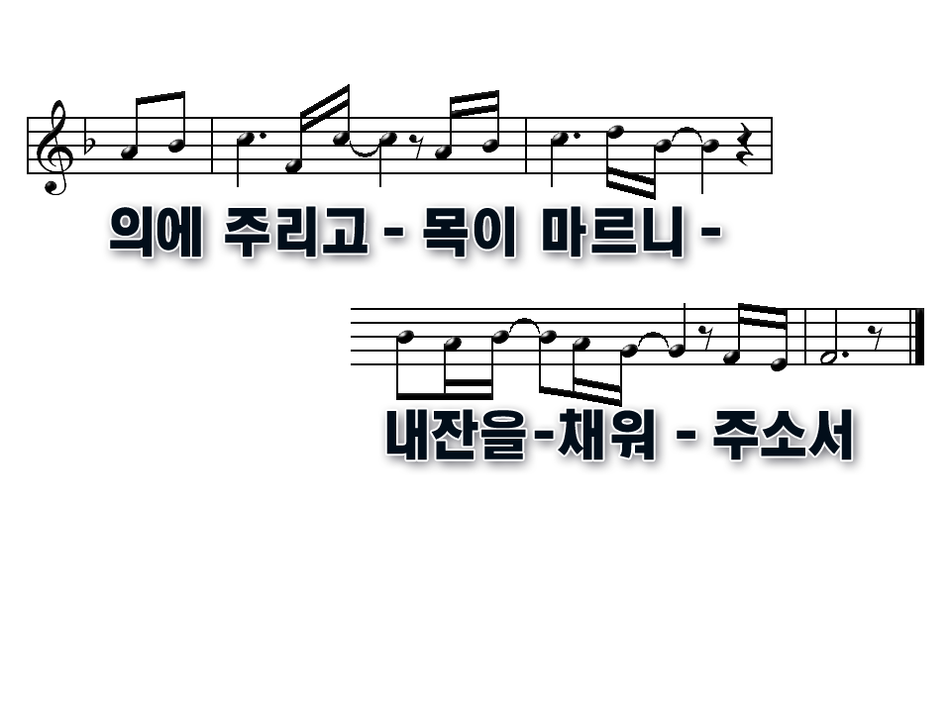
Lord, I hunger, thirst for Your righteousness
Fill me with Your oil and Your wine
1
2

Slide 5
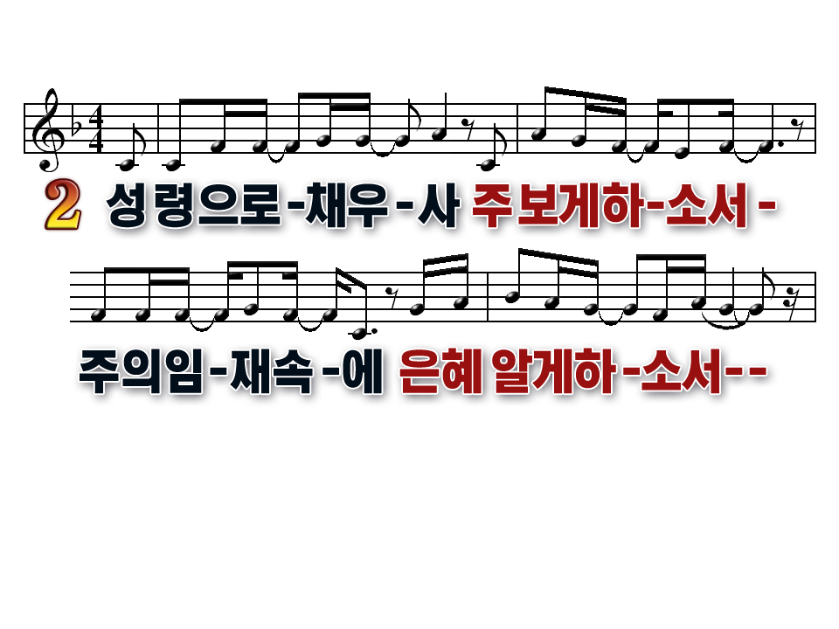
Fill me with Your Spirit
I want to see Your face
To live in Your presence
Know Your glory and Your grace
1
2

Slide 6
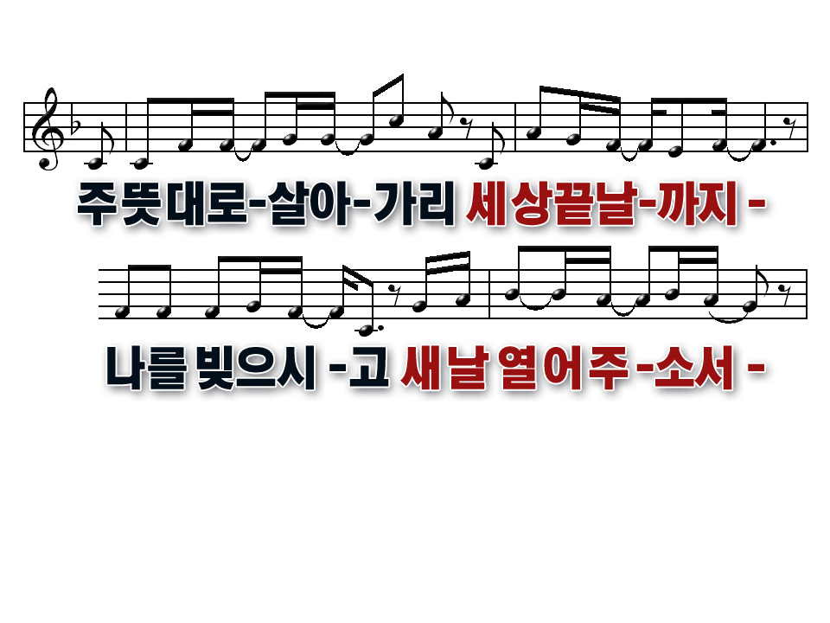
It's not my will but Yours I choose
To follow to the end
So mold me, yes, and make me
Let a new day begin
1
2

Slide 7
Lord, I hunger, thirst for Your righteousness
Father come and fill me once again
1
2

Slide 8
Lord, I hunger, thirst for Your righteousness
Fill me with Your oil and Your wine
1
2

