Slide 1
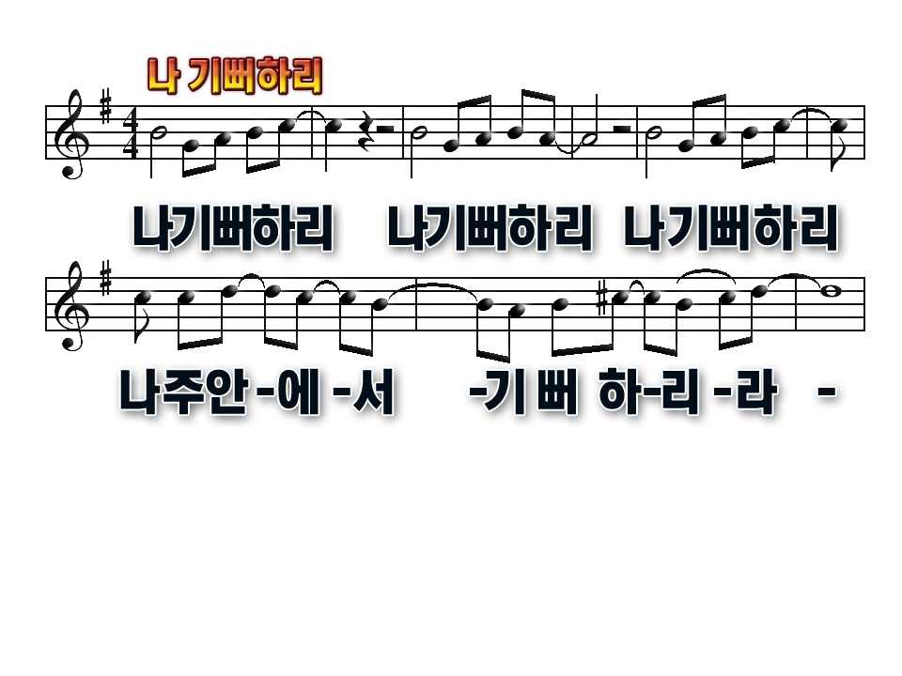
I will rejoice I will rejoice I will rejoice
For I’ve made my choice
To rejoice in the Lord

Slide 2
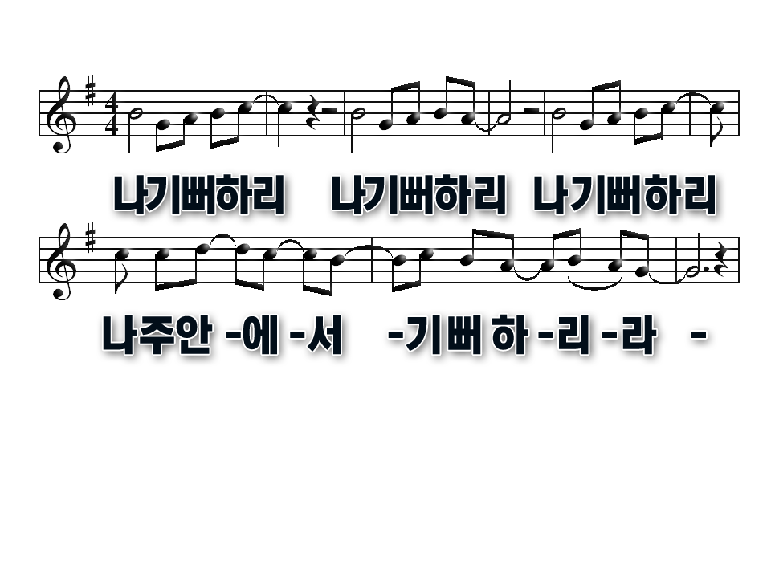
I will rejoice I will rejoice I will rejoice
For I’ve made my choice
To rejoice in the Lord

Slide 3
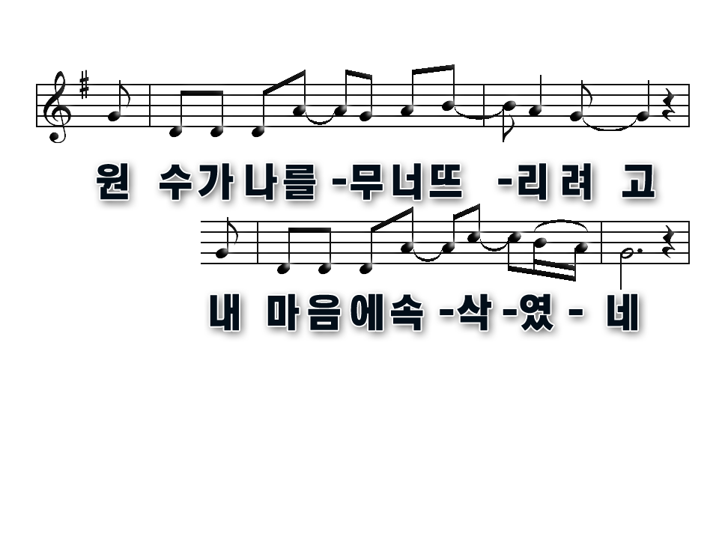
The enemy whispered into my mind
Determined to wear me down

Slide 4
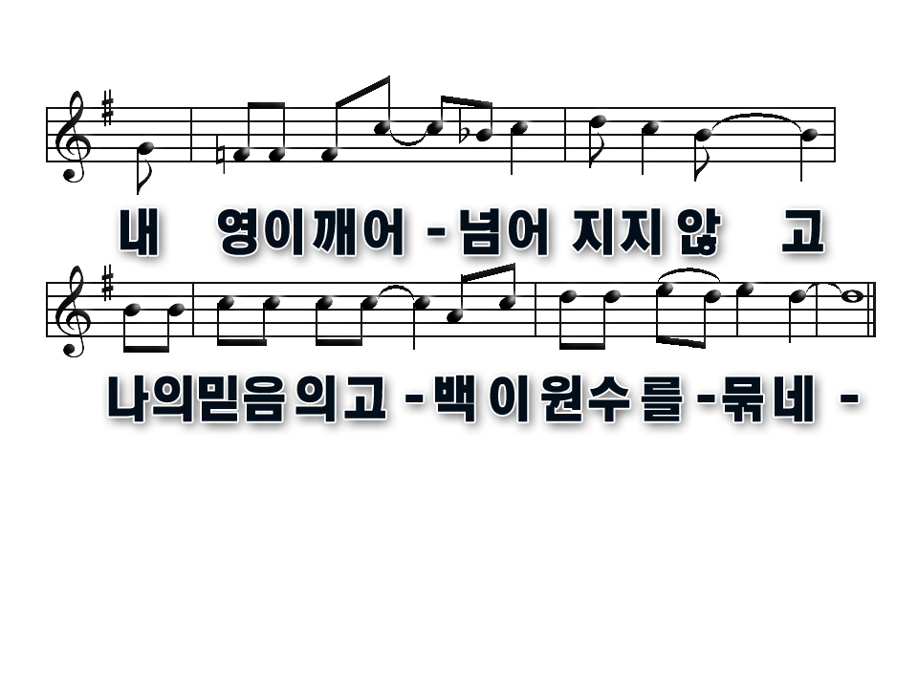
Alert in the Spirit I'm not blind
My confession of faith
Has the enemy bound

Slide 5
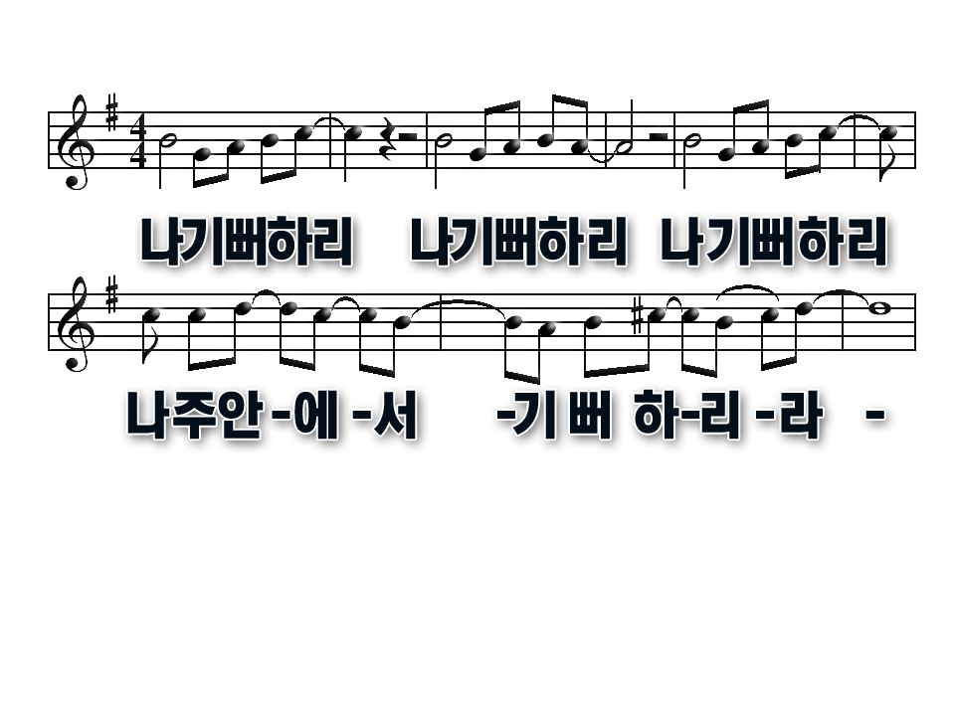
I will rejoice I will rejoice I will rejoice
For I’ve made my choice
To rejoice in the Lord

Slide 6
I will rejoice I will rejoice I will rejoice
For I’ve made my choice
To rejoice in the Lord

Slide 7
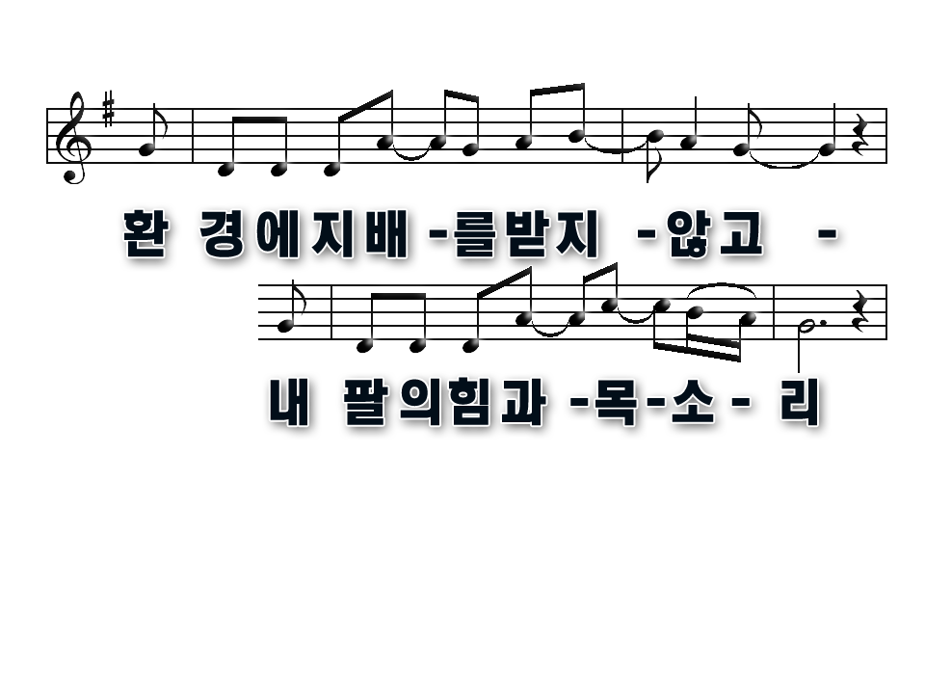
It doesn't depend on
The circumstance
The strength of my arm or my voice

Slide 8
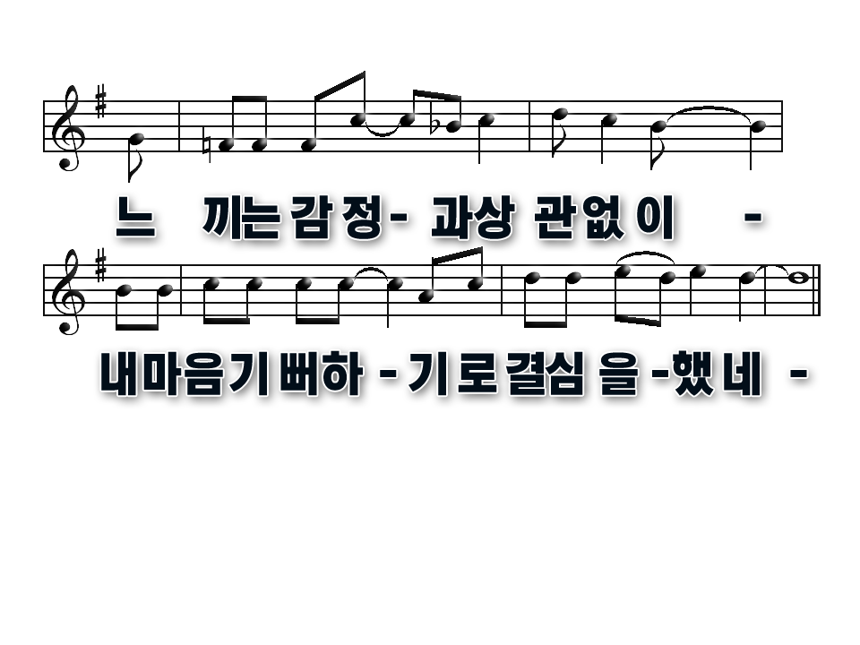
It doesn’t depend on the way I feel
I've made up my mind
And I’m gonna rejoice

Slide 9
I will rejoice I will rejoice I will rejoice
For I’ve made my choice
To rejoice in the Lord

Slide 10
I will rejoice I will rejoice I will rejoice
For I’ve made my choice
To rejoice in the Lord

Slide 11
I will rejoice I will rejoice I will rejoice
For I’ve made my choice
To rejoice in the Lord

Slide 12
I will rejoice I will rejoice I will rejoice
For I’ve made my choice
To rejoice in the Lord

