Slide 1
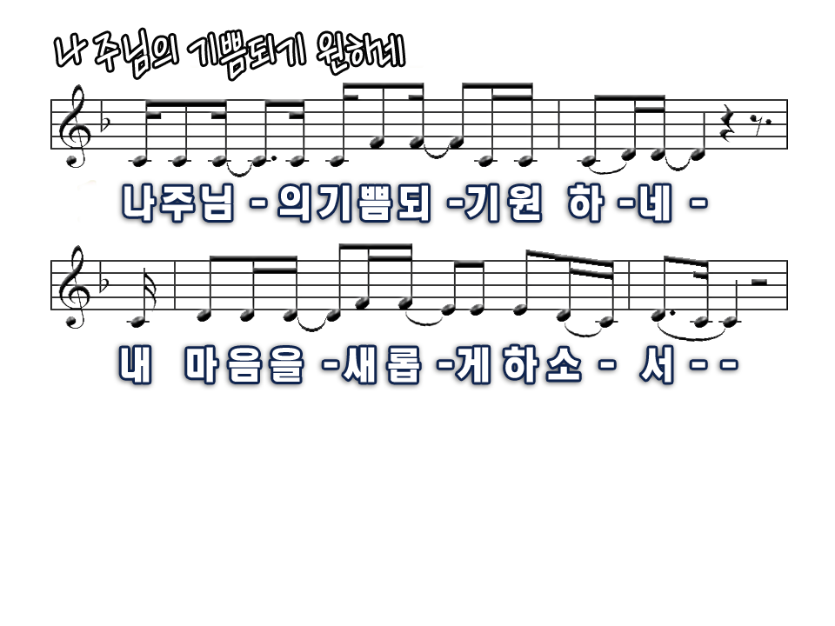
Lord, I want to live my life to please You
I bring my heart before You to re - mold

Slide 2
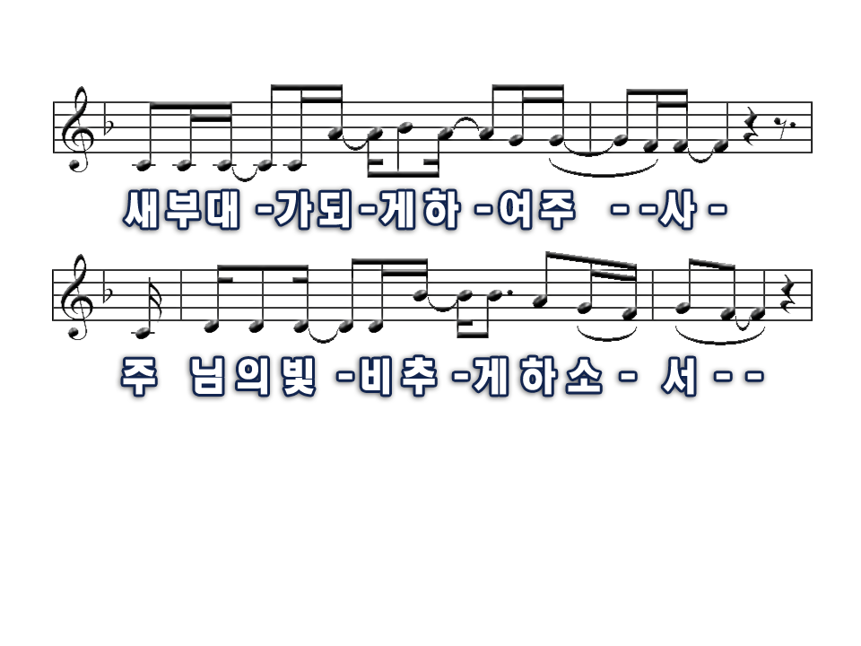
Make me a vessel fit for honor
That I might shine for You as sparkling gold

Slide 3
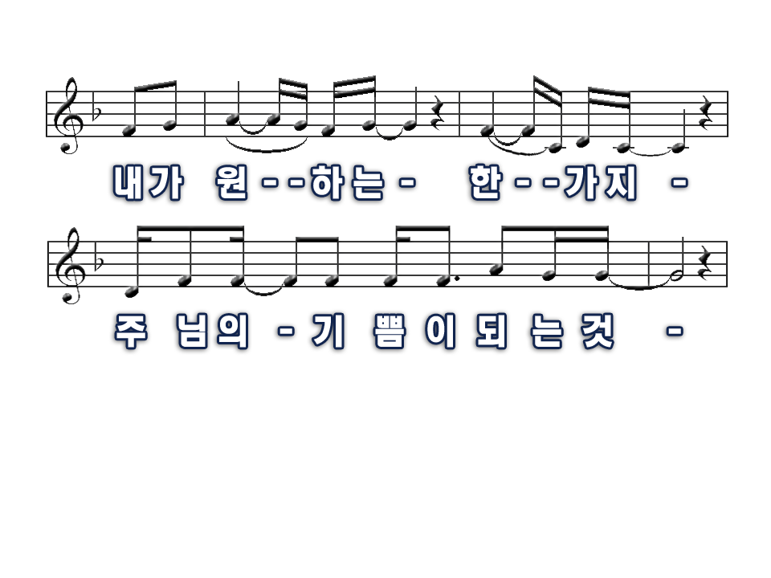
To be pleasing You, pleasing You
This is all I really want to do

Slide 4
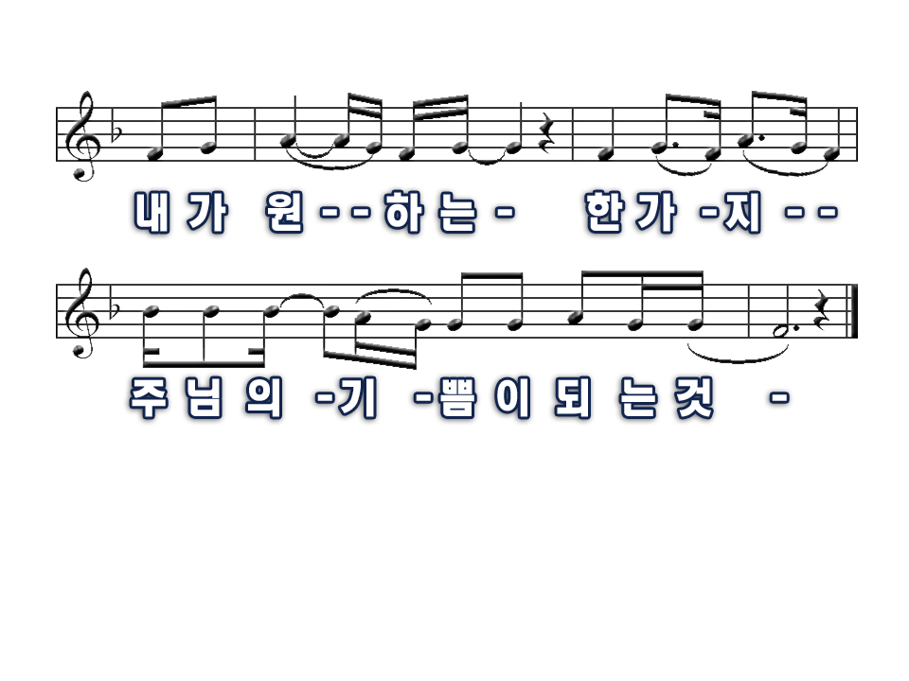
To be pleasing You, pleasing You
This is all I really want to do

Slide 5
To be pleasing You, pleasing You
This is all I really want to do

Slide 6
To be pleasing You, pleasing You
This is all I really want to do

