Slide 1
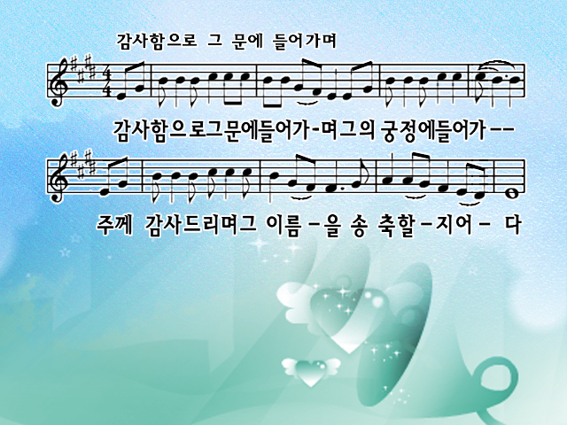
I will enter His gates with thanksgiving in my heart;
I will enter His courts with praise.
I will say this is the day that the Lord has made.
I will rejoice for He has made me glad.

Slide 2
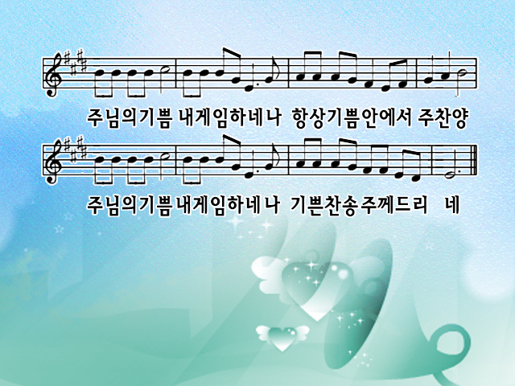
He has made me glad, He has made me glad,
I will rejoice for He has made me glad.
He has made me glad, He has made me glad,
I will rejoice for He has made me glad.

Slide 3
I will enter His gates with thanksgiving in my heart;
I will enter His courts with praise.
I will say this is the day that the Lord has made.
I will rejoice for He has made me glad.

Slide 4
He has made me glad, He has made me glad,
I will rejoice for He has made me glad.
He has made me glad, He has made me glad,
I will rejoice for He has made me glad.

