Slide 1
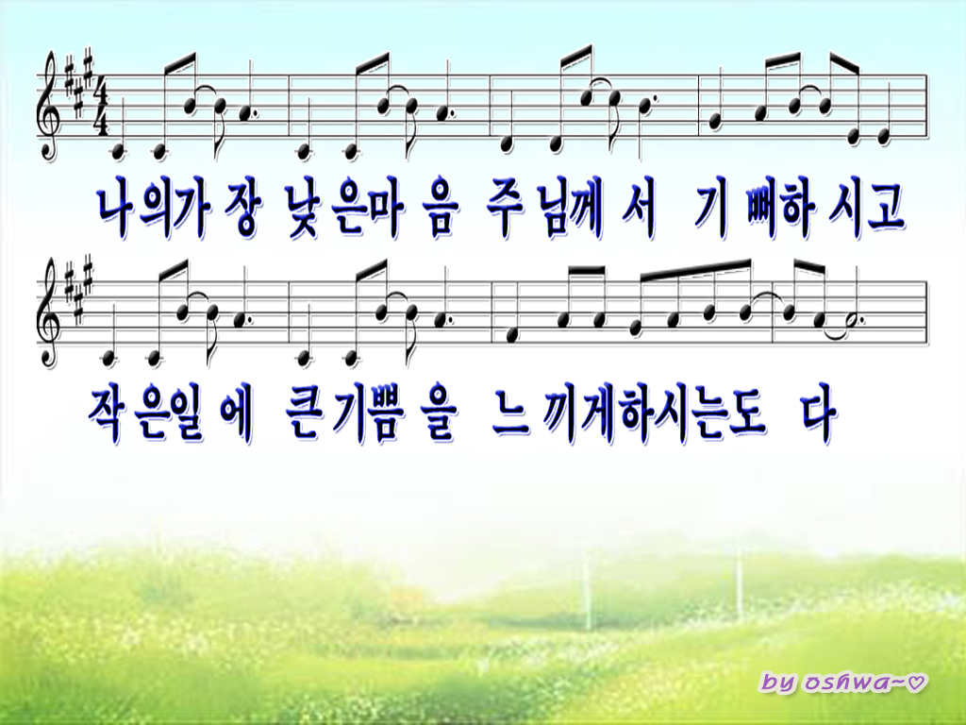
I have poor mind, It’s what the Lord
delighted at me I can be pleased with a trifle
It’s what the Lord has done in my heart

Slide 2
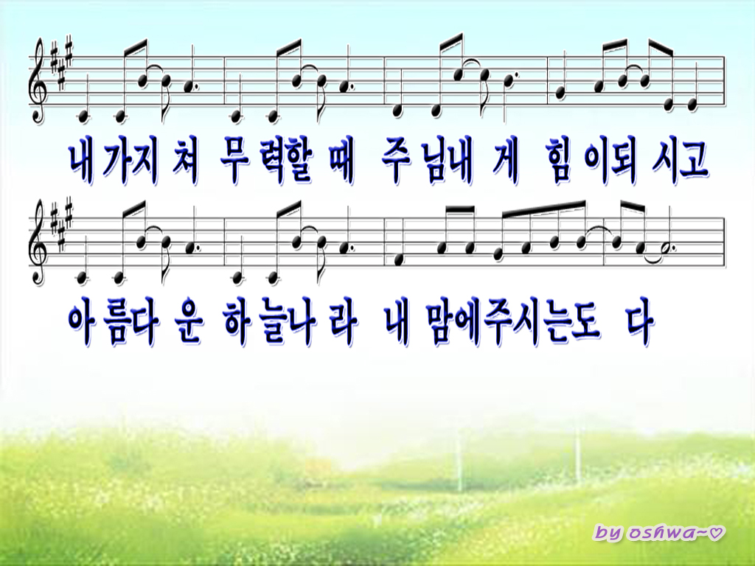
I overcome getting tired It’s what the Lord comfort to me I can dream
beautiful Kingdom It’s what the Lord has done in my heart

Slide 3
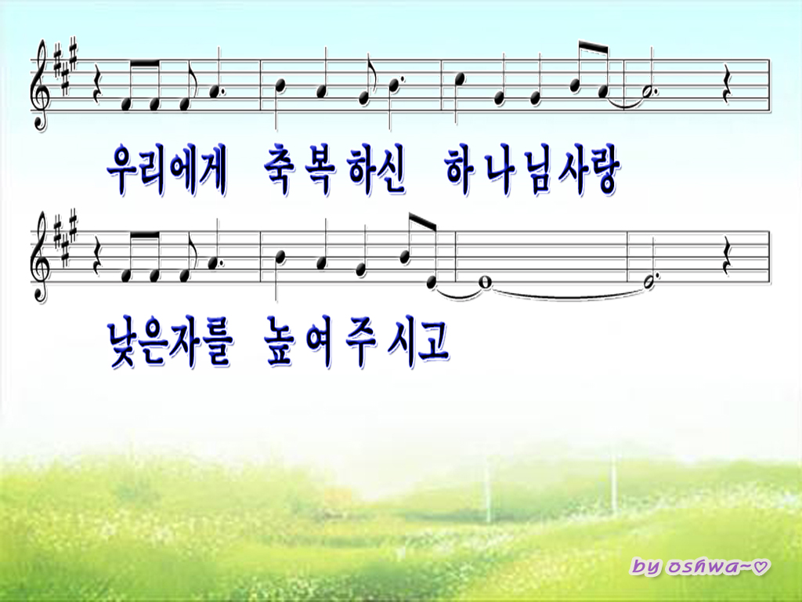
His love, it’s the power of blessing me
Let poor soul hold in his nation

Slide 4
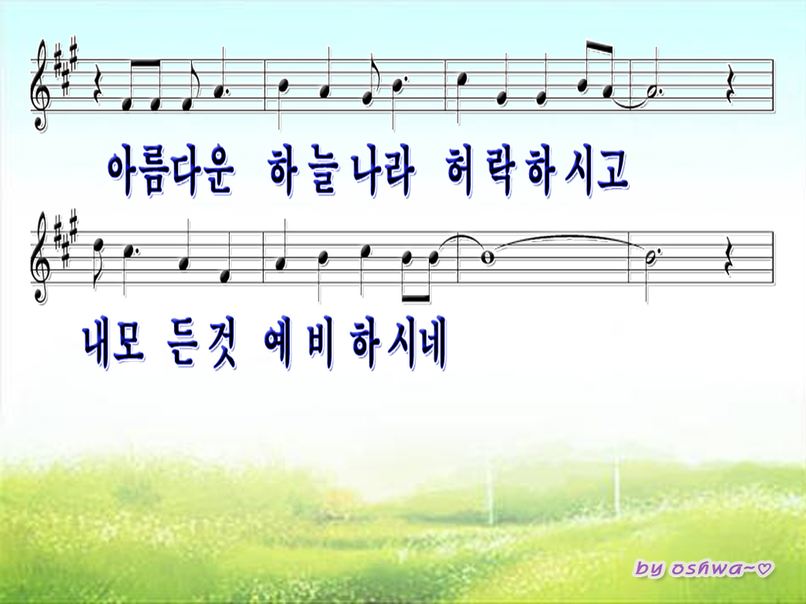
His love, it keep my heart to see His Kingdom
Let me prepare for everything

Slide 5
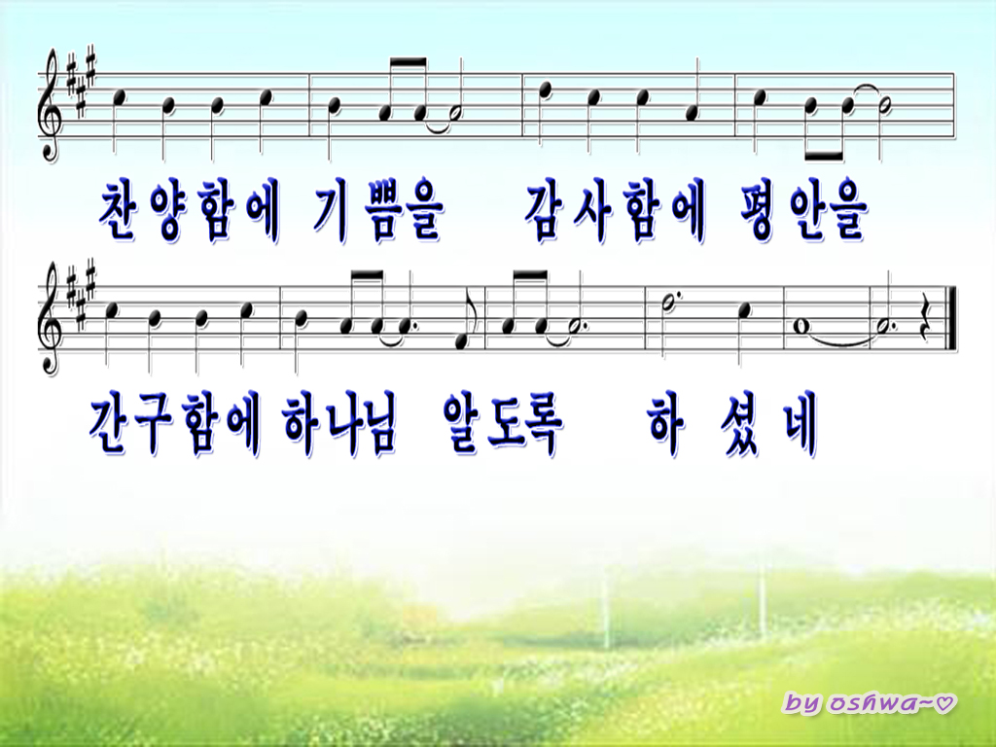
Praise with a grateful heart Thanks with a peaceful heart
Look up the almighty God with all my hope

