Slide 1
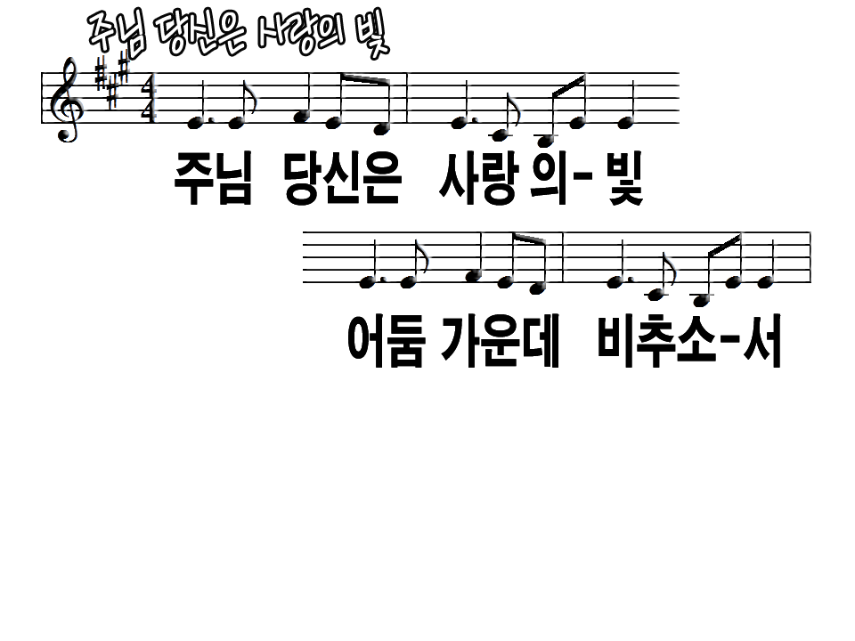
Lord the Light of Your Love is shining,
In the midst of the darkness shining,

Slide 2
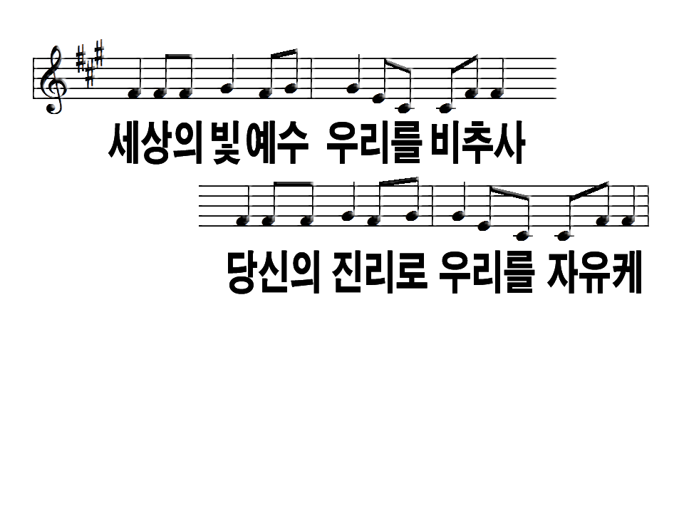
Jesus, Light of the World, shine upon us,
Set us free by the truth You now bring us,

Slide 3
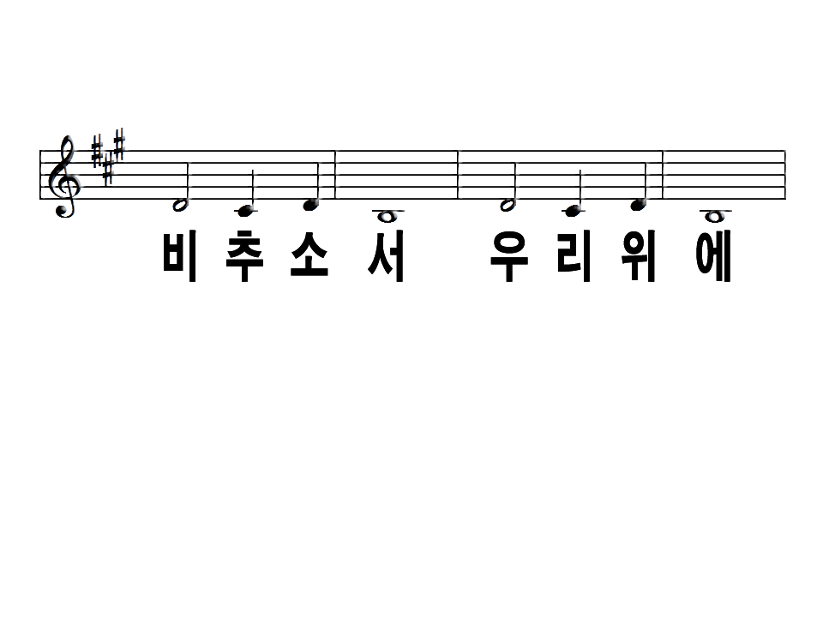
Shine on me. Shine on me.

Slide 4
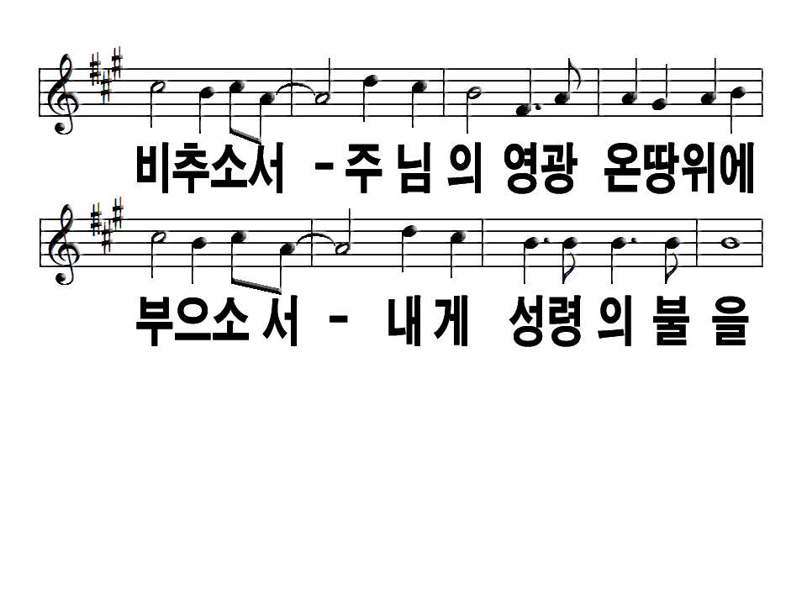
Shine Jesus shine Fill this land with the Father's glory
Blaze, Spirit blaze, Set our hearts on fire

Slide 5
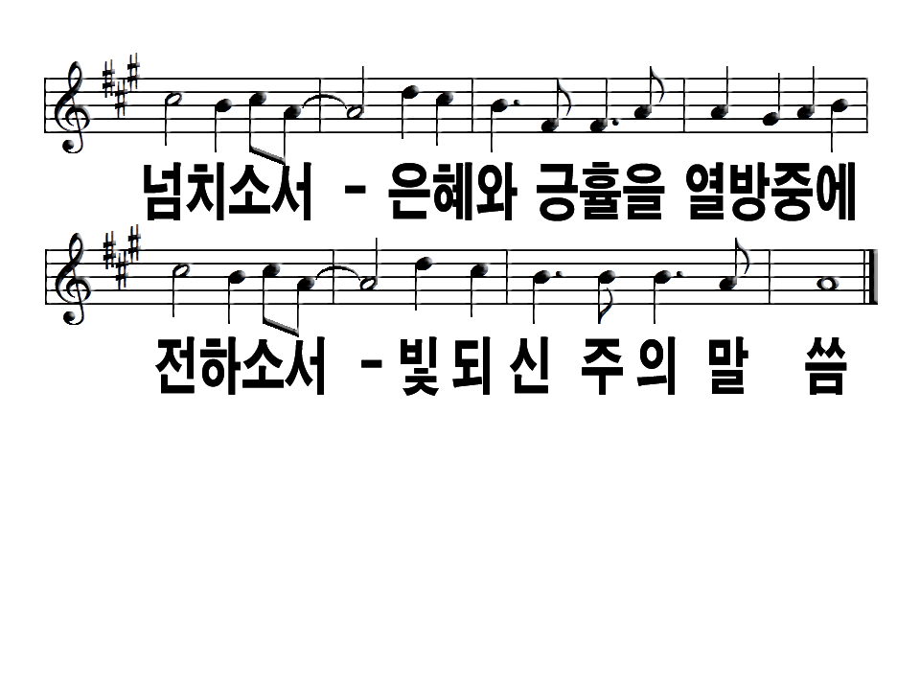
Flow, river flow Flood the nations with grace and mercy
Send forth Your word Lord and let there be light.

Slide 6
Lord the Light of Your Love is shining,
In the midst of the darkness shining,

Slide 7
Jesus, Light of the World, shine upon us,
Set us free by the truth You now bring us,

Slide 8
Shine on me. Shine on me.

Slide 9
Shine Jesus shine Fill this land with the Father's glory
Blaze, Spirit blaze, Set our hearts on fire

Slide 10
Flow, river flow Flood the nations with grace and mercy
Send forth Your word Lord and let there be light.

