Slide 1
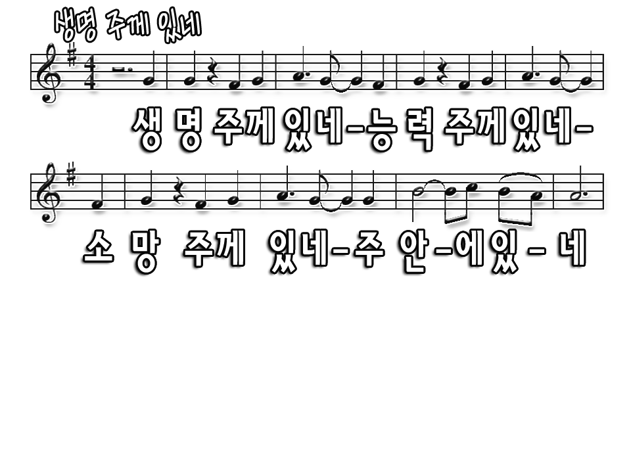
My life is in You, Lord My strength is in You, Lord
My hope is in You, Lord In You, it's in You

Slide 2
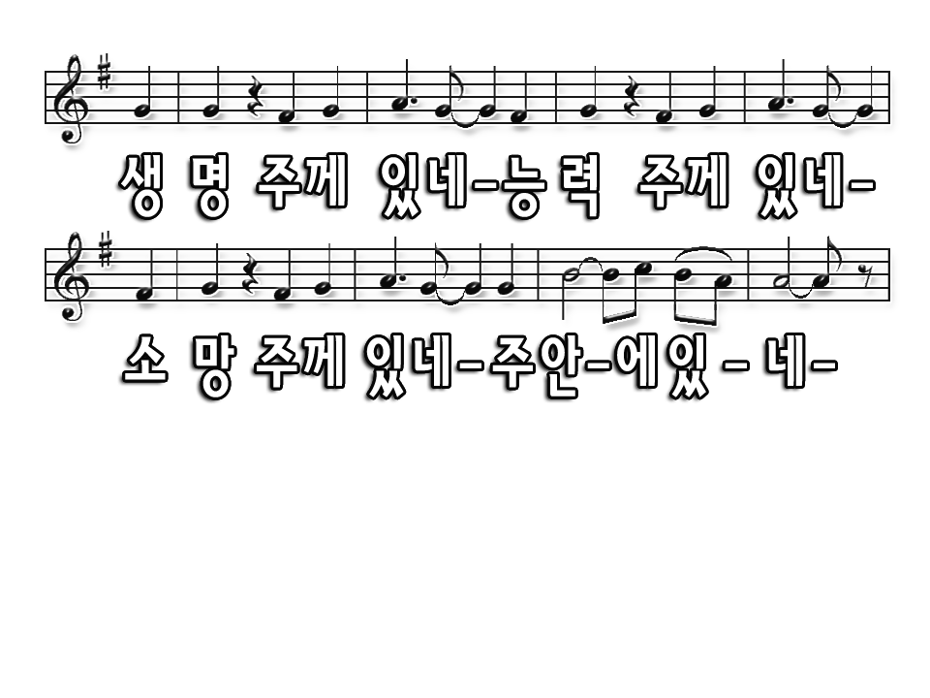
My life is in You, Lord My strength is in You, Lord
My hope is in You, Lord In You, it's in You

Slide 3
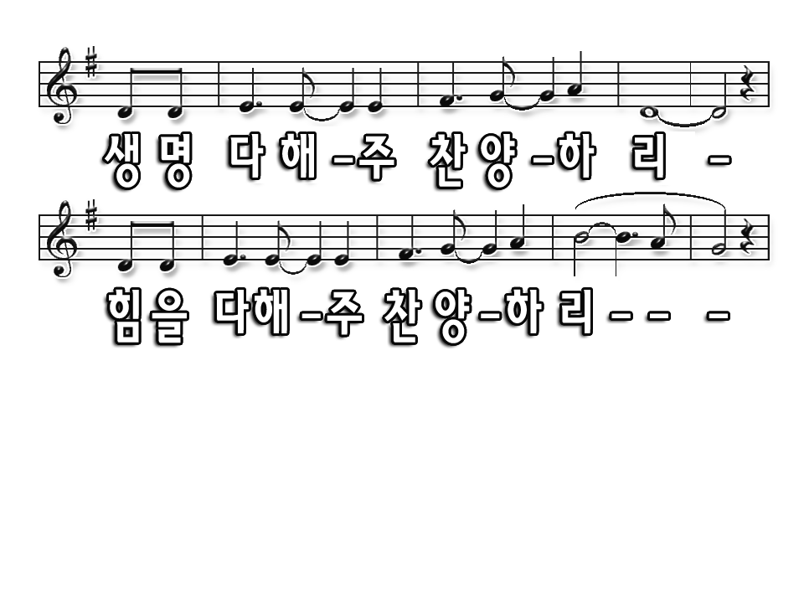
I will praise You with all of my life
I will praise You with all of my strength

Slide 4
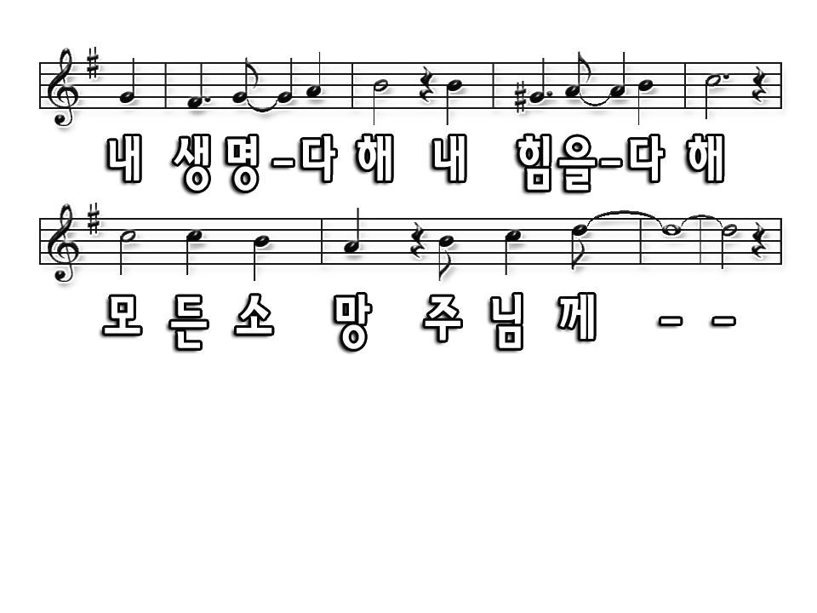
With all of my life, with all of my strength,
All of my hope is in You.

Slide 5
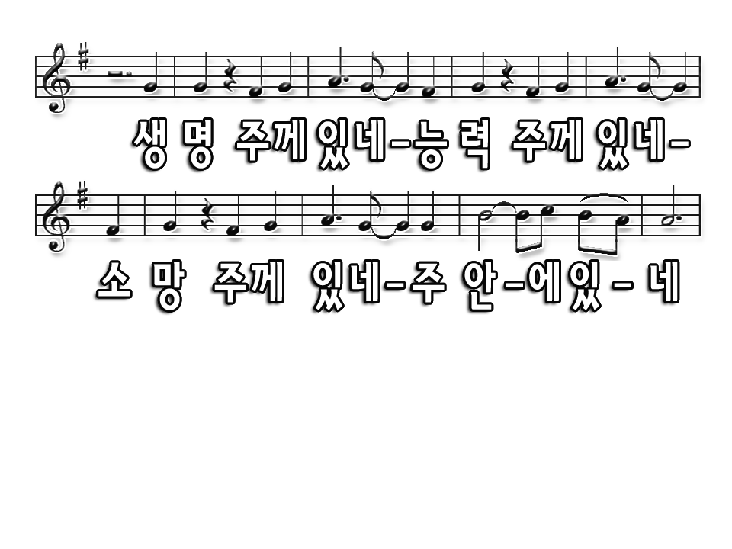
My life is in You, Lord My strength is in You, Lord
My hope is in You, Lord In You, it's in You

Slide 6
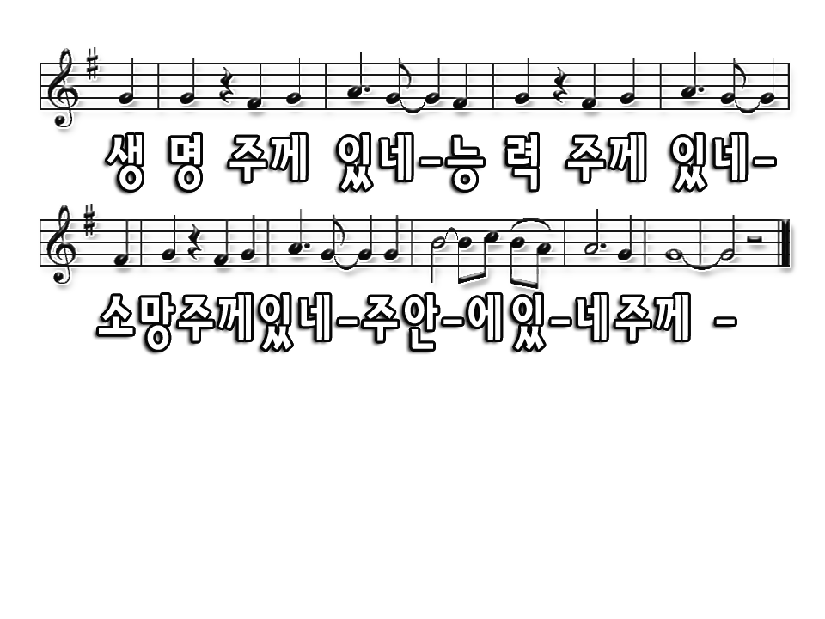
My life is in You, Lord My strength is in You, Lord
My hope is in You, Lord In You, it's in You

