Slide 1
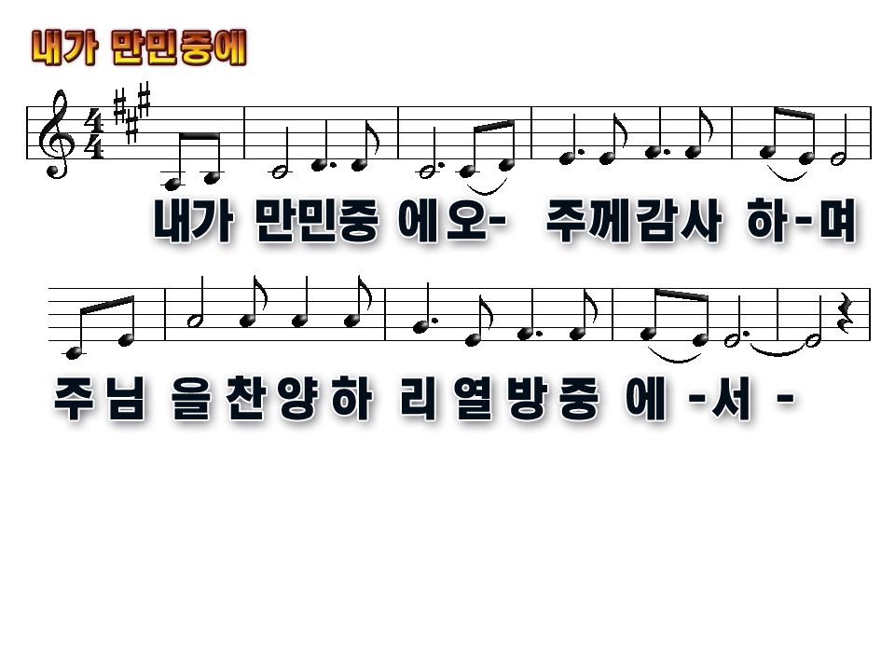
I will give thanks to Thee
O Lord among the people
I will sing praises to Thee
among the nations

Slide 2
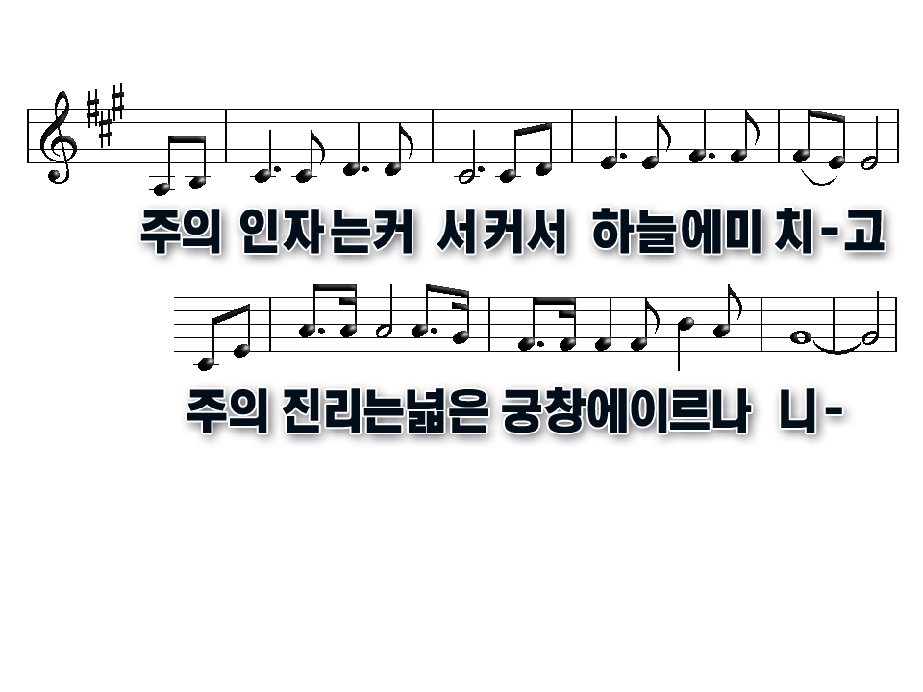
For Thy steadfast love is great
It is great to the heavens
And Thy faithfulness,
Thy faithfulness to the clouds

Slide 3
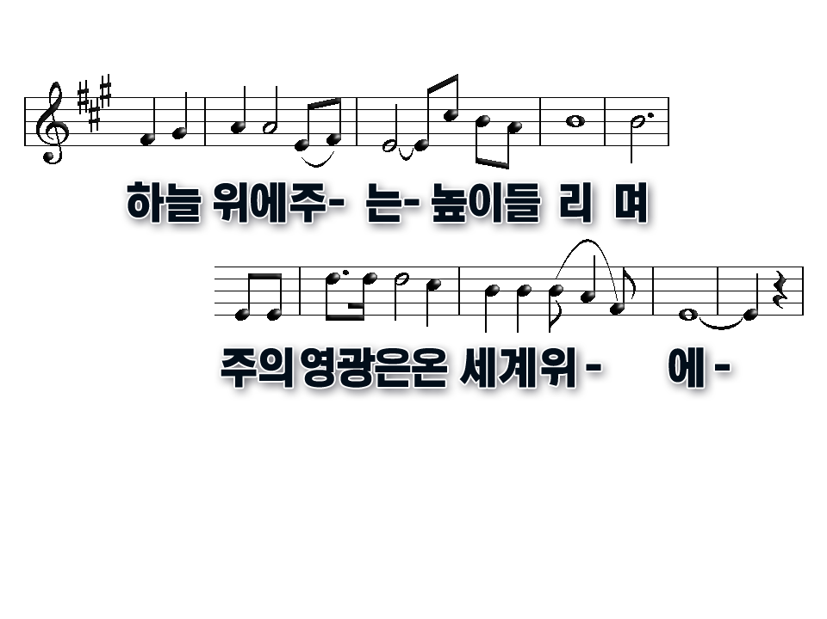
Be exalted, O God, above the heavens
Let Thy glory be over all the earth

Slide 4
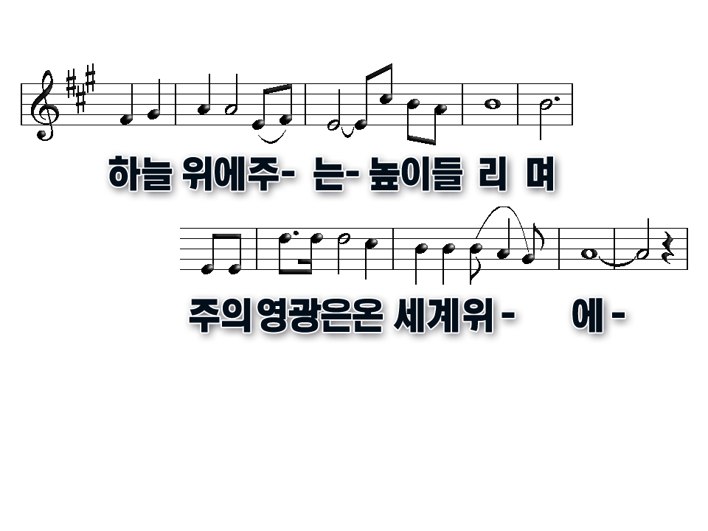
Be exalted, O God, above the heavens
Let Thy glory be over all the earth

Slide 5
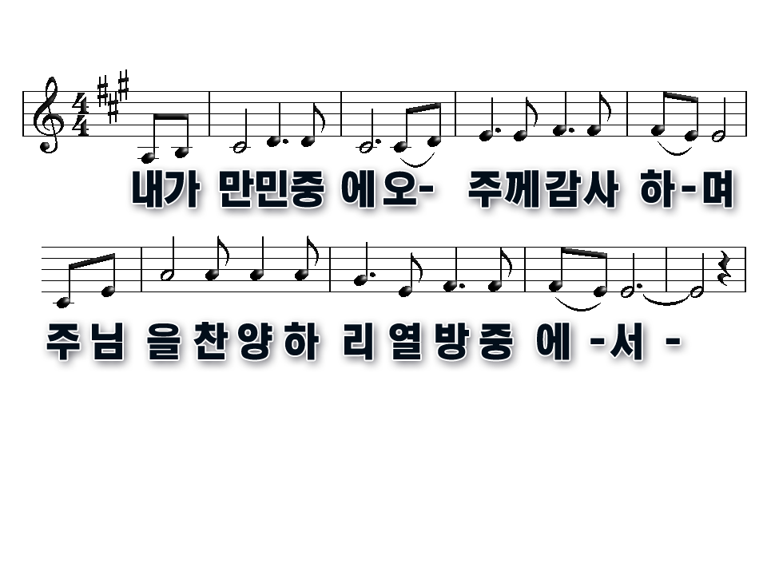
I will give thanks to Thee
O Lord among the people
I will sing praises to Thee
among the nations

Slide 6
For Thy steadfast love is great
It is great to the heavens
And Thy faithfulness,
Thy faithfulness to the clouds

Slide 7
Be exalted, O God, above the heavens
Let Thy glory be over all the earth

Slide 8
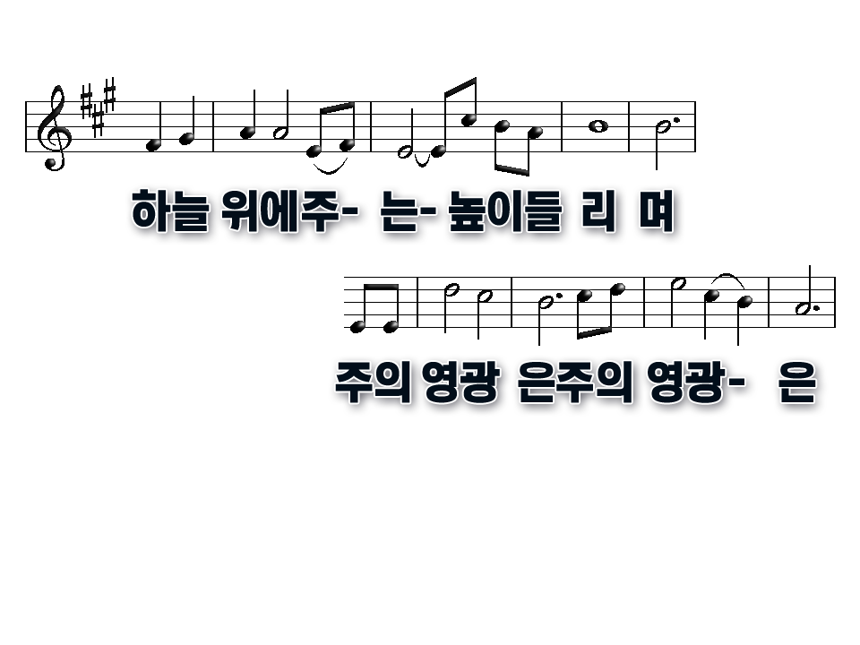
Be exalted, O God, above the heavens
Let Thy glory, let Thy glory

Slide 9
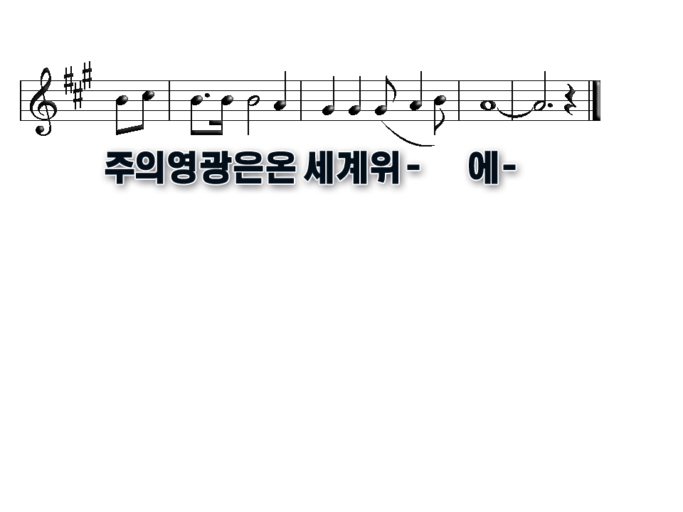
Let Thy glory be over all the earth

