Slide 1
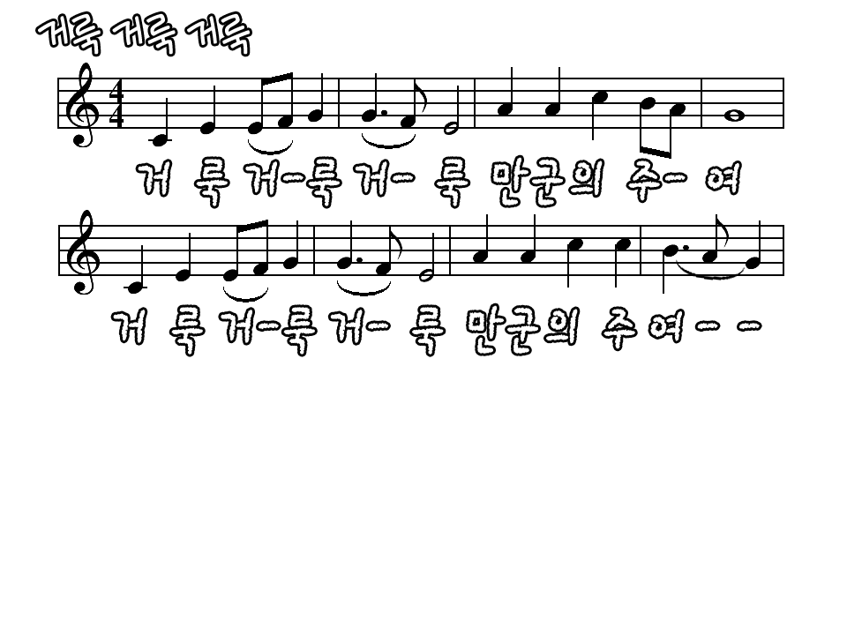
Holy holy holy is the Lord of hosts
Holy holy holy is the Lord of hosts

Slide 2
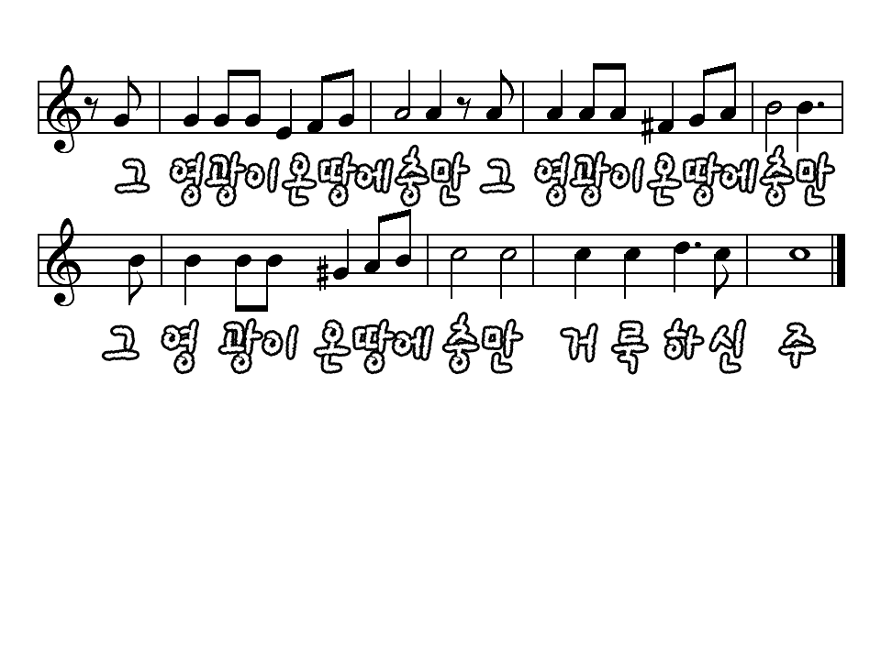
The whole earth is full of His glory
The whole earth is full of His glory

Slide 3
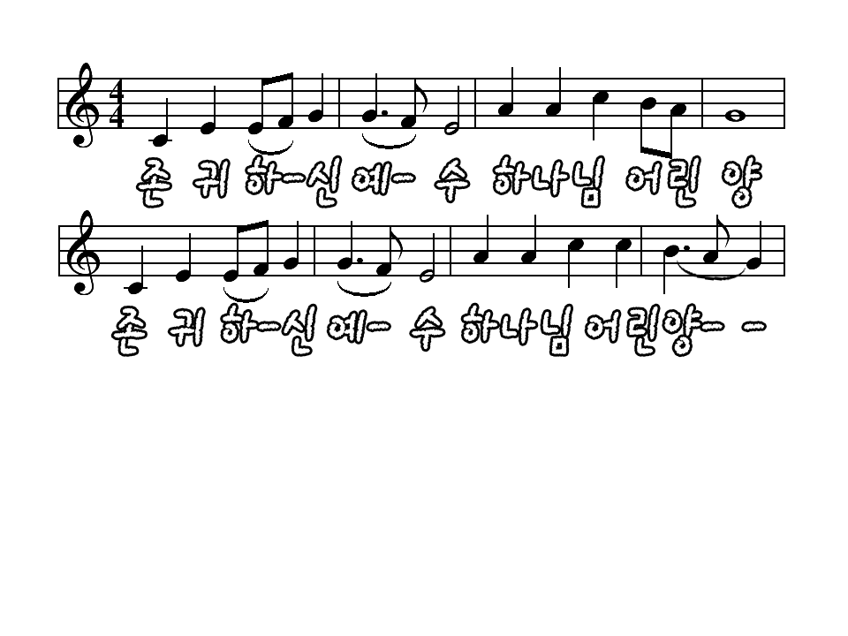
Holy holy holy is the Lord of hosts
Holy holy holy is the Lord of hosts

Slide 4
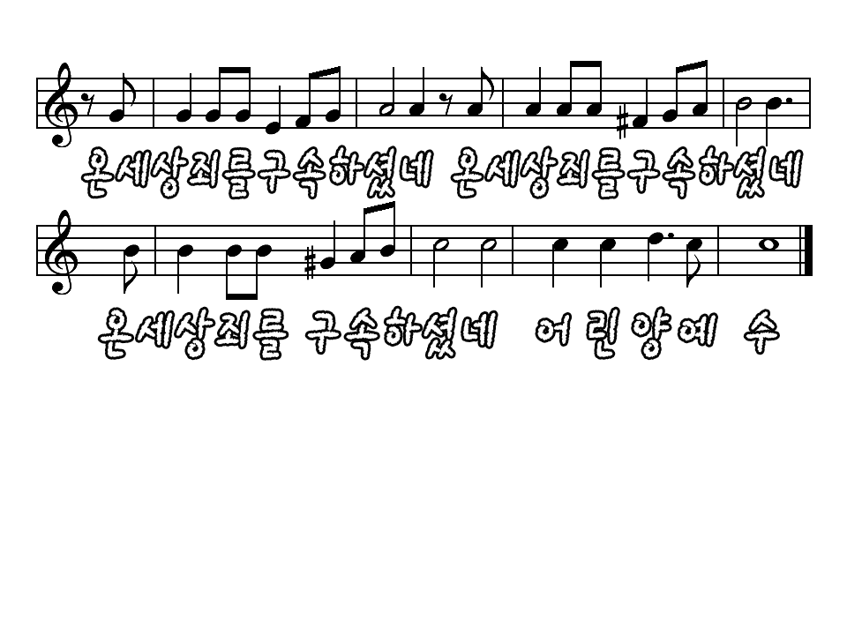
The whole earth is full of His glory
The whole earth is full of His glory
Holy is the Lord

