Slide 1
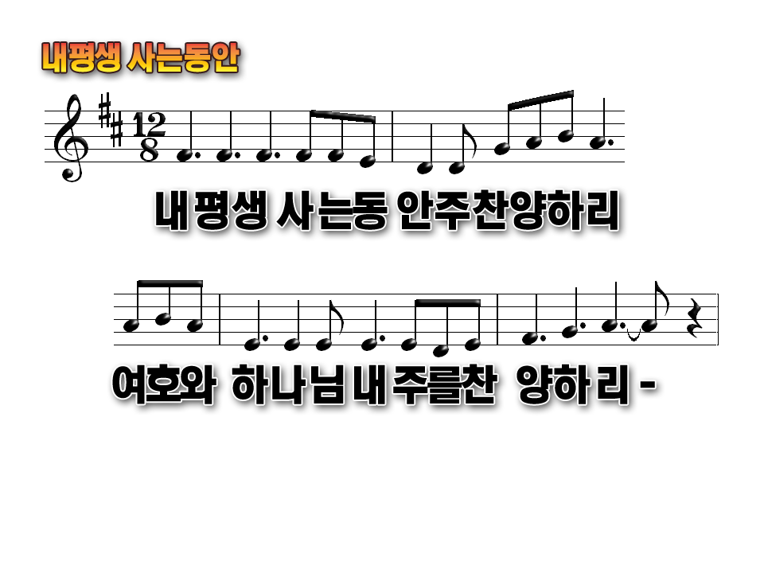
I will sing unto the Lord as long as I live
I will sing praise to my God while I have life in me

Slide 2
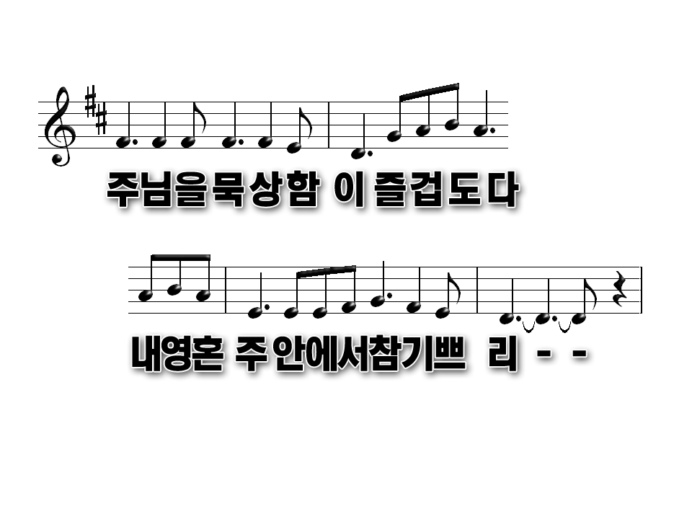
My meditation of Him shall be sweet
I will be glad, I will be glad in the Lord

Slide 3
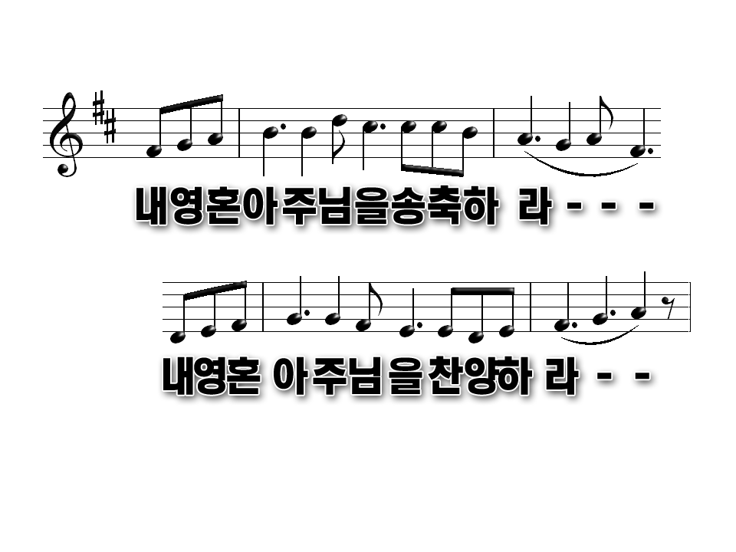
Bless thou the Lord, O my soul Praise ye the Lord
Bless thou the Lord, O my soul Praise ye the Lord

Slide 4
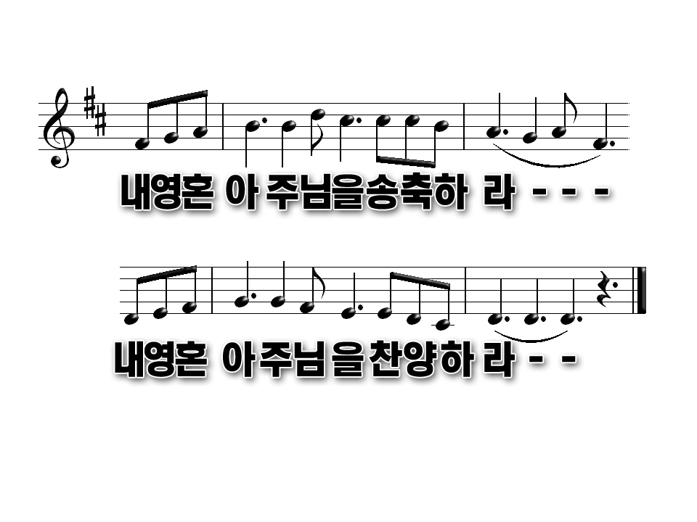
Bless thou the Lord, O my soul Praise ye the Lord
Bless thou the Lord, O my soul Praise ye the Lord

Slide 5
I will sing unto the Lord as long as I live
I will sing praise to my God while I have life in me

Slide 6
My meditation of Him shall be sweet
I will be glad, I will be glad in the Lord

Slide 7
Bless thou the Lord, O my soul Praise ye the Lord
Bless thou the Lord, O my soul Praise ye the Lord

Slide 8
Bless thou the Lord, O my soul Praise ye the Lord
Bless thou the Lord, O my soul Praise ye the Lord

