Slide 1
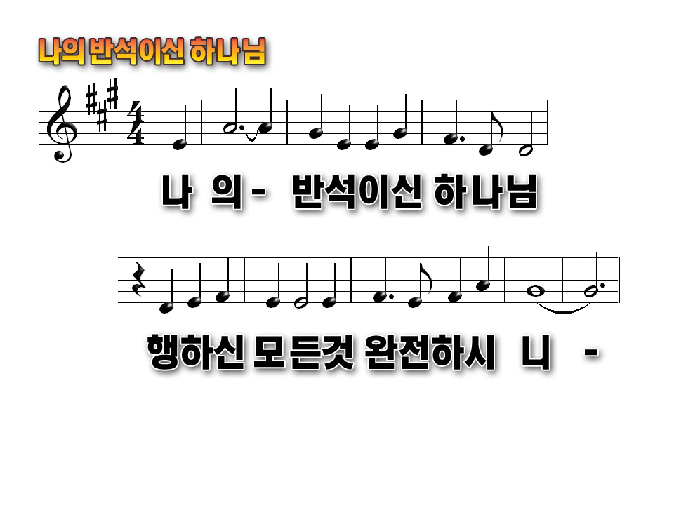
As-cribe greatness to our God the Rock
His work is perfect and all His ways are just

Slide 2
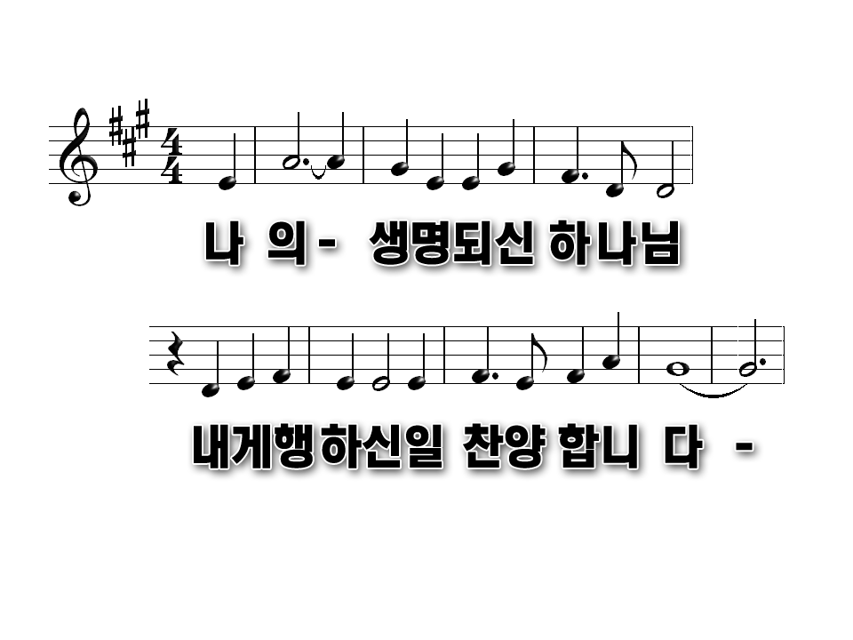
As-cribe greatness to our God the Rock
His work is perfect and all His ways are just

Slide 3
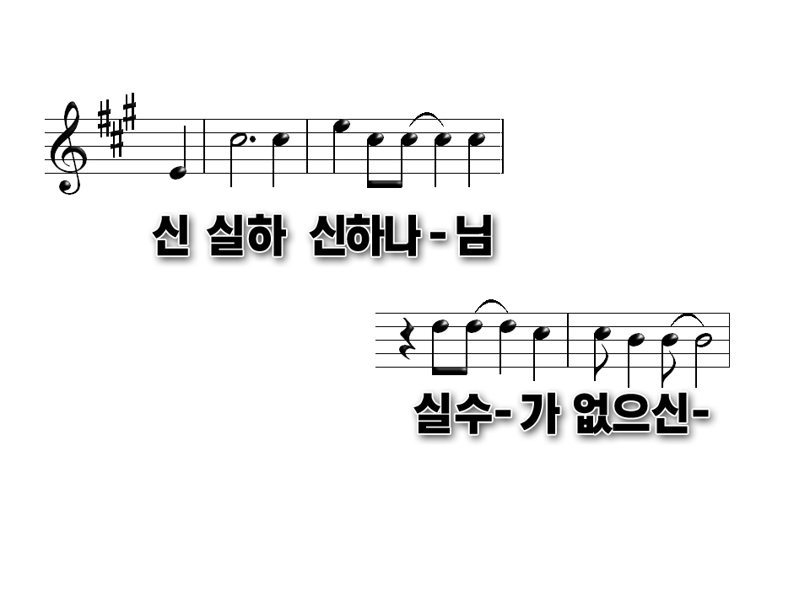
A God of faithfulness and,
Without in – jus-tice

Slide 4
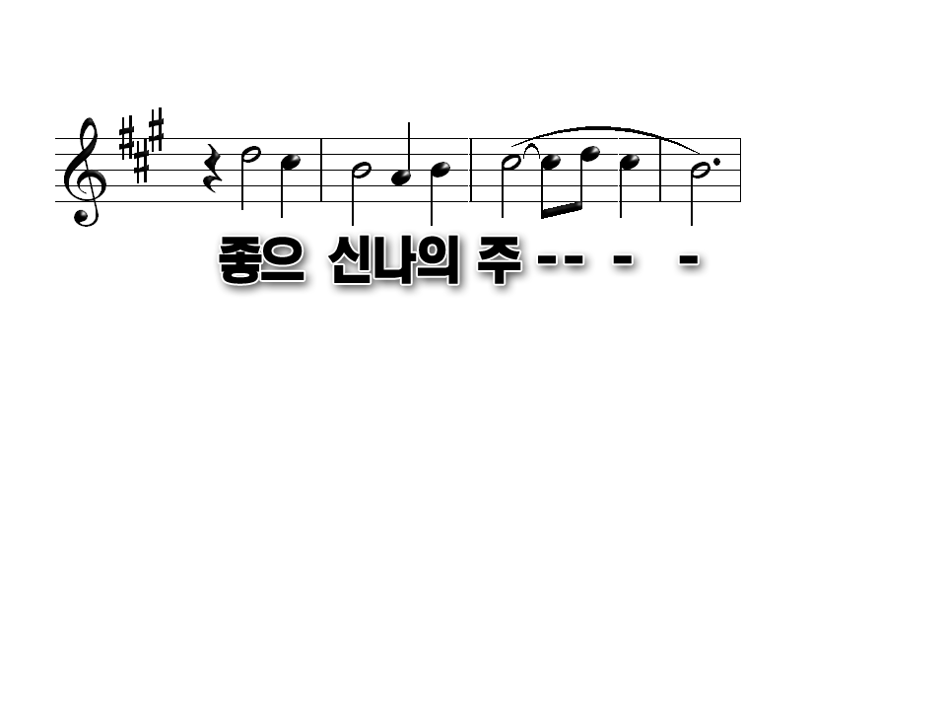
Good and up-right is He

Slide 5
A God of faithfulness and,
Without in – jus-tice

Slide 6
Good and up-right is He

