Slide 1
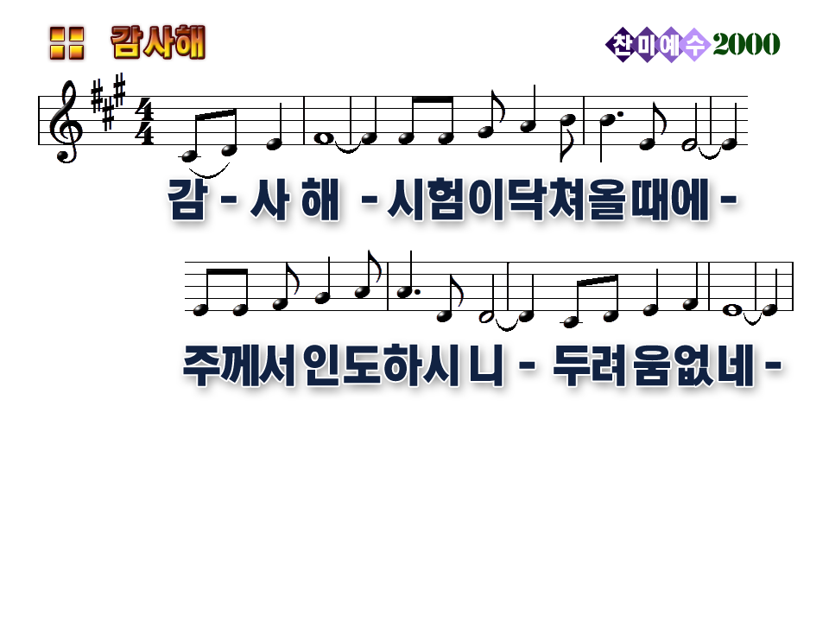
Thank You Lord for the trials that come my way
in that way I can grow each day as I let You lord

Slide 2
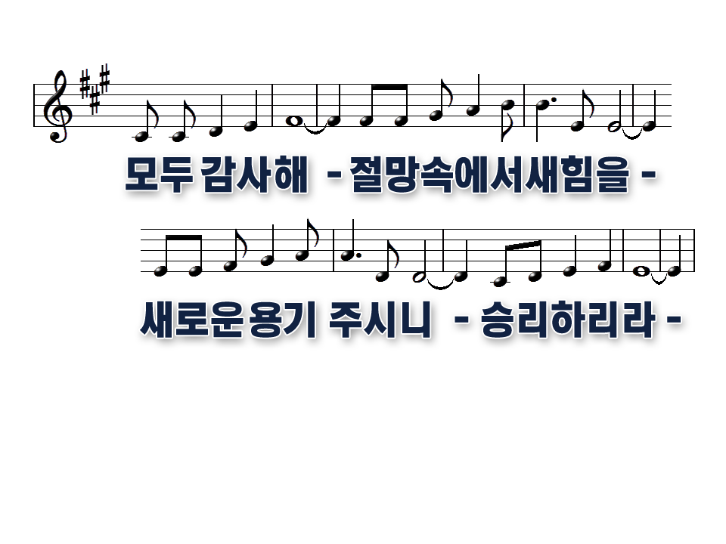
and I thank you Lord for the patience those trials bring
in the process of growing I can learn to care

Slide 3
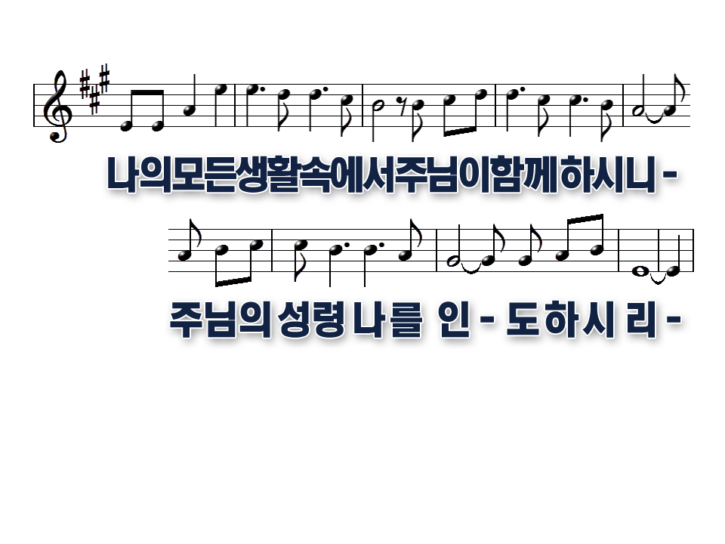
But it goes against the way I am to put my human nature down
and let the spirit take control of all I do

Slide 4
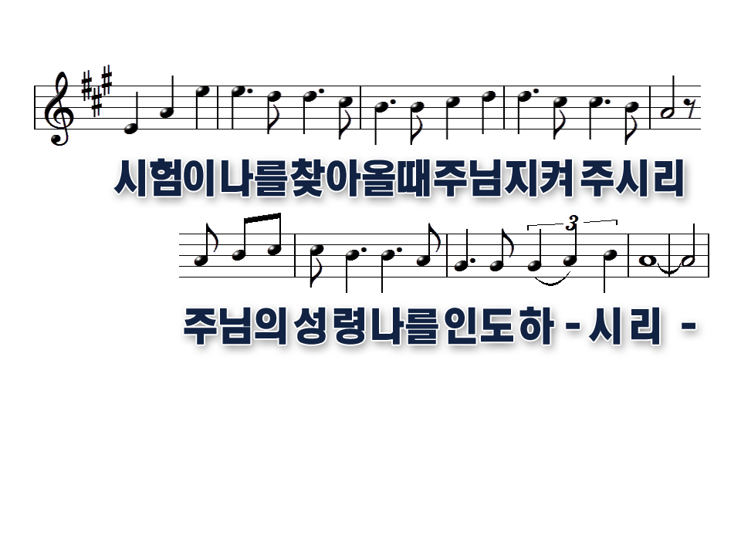
cause when those trials come, my human nature shouts the things to do
and God’s soft prompting can be easily ignored

Slide 7
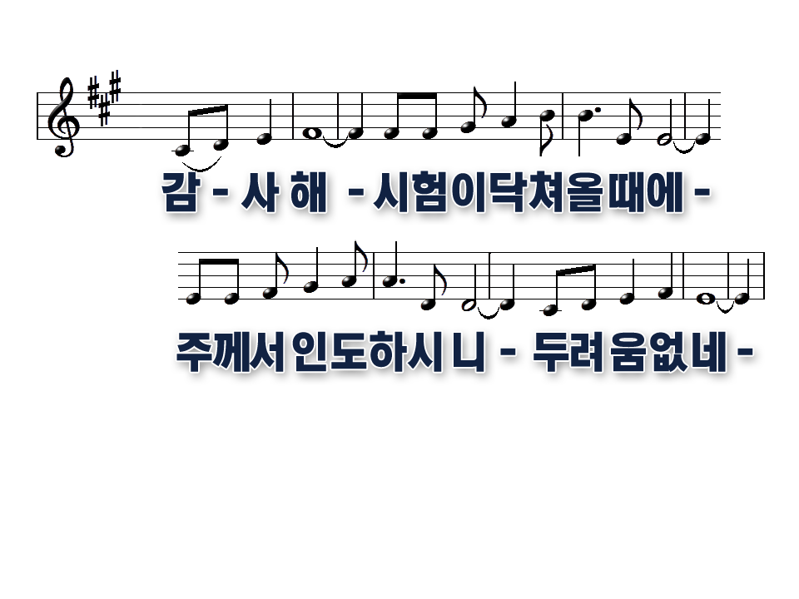
Thank you lord with each trial I feel inside
that you’re there to help lead and guide me away from wrong

Slide 8
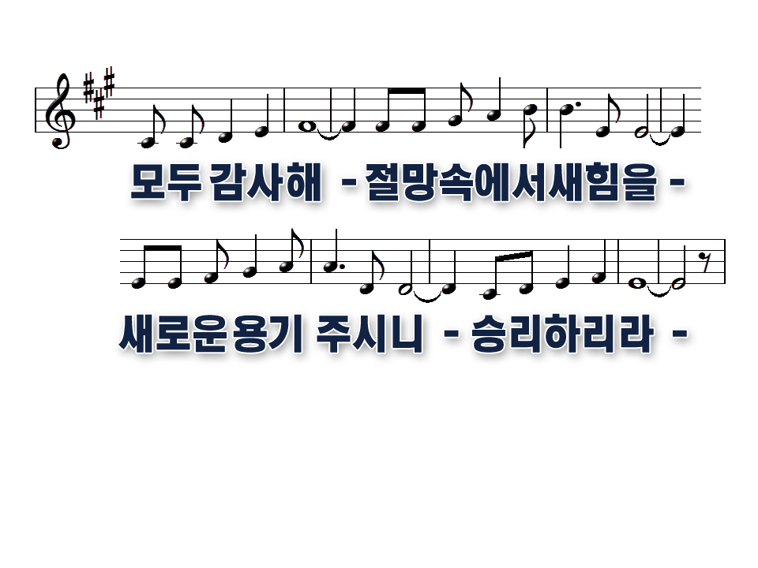
Cause you promised Lord that with trouble and testing
that your way of escaping is easier to bear

Slide 9
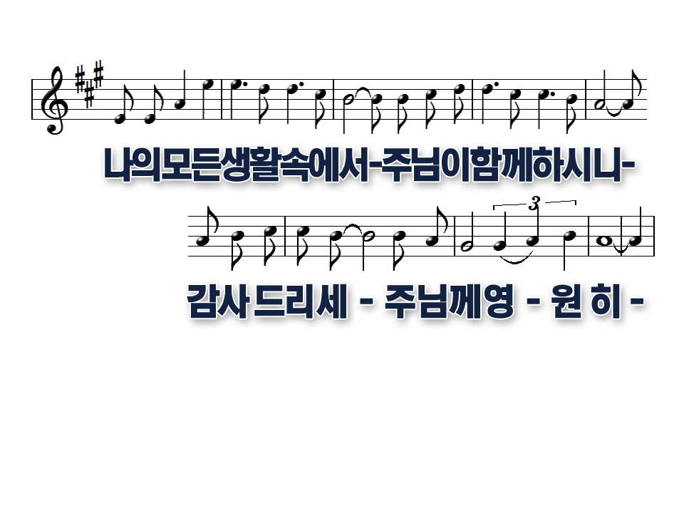

Slide 10
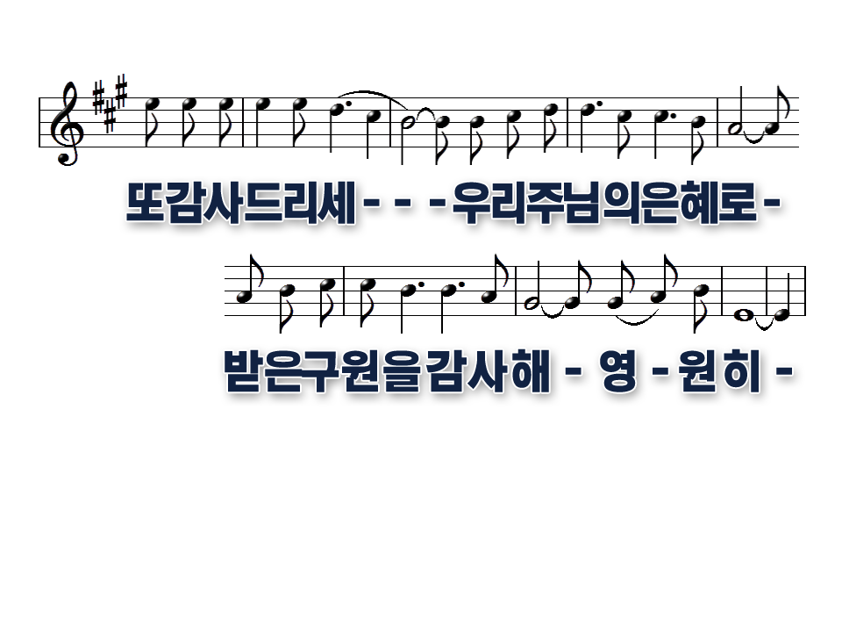

Slide 11


Slide 17
