Slide 1
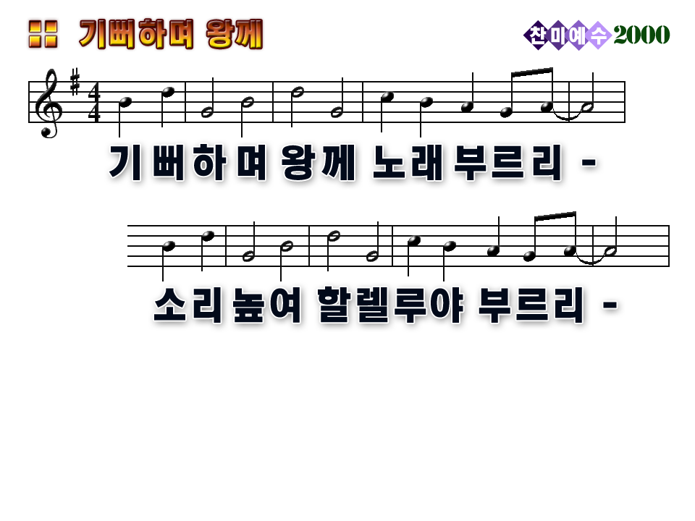
Shout for joy and sing your praises to the King
Lift your voice high, let your Hallelujahs ring

Slide 2
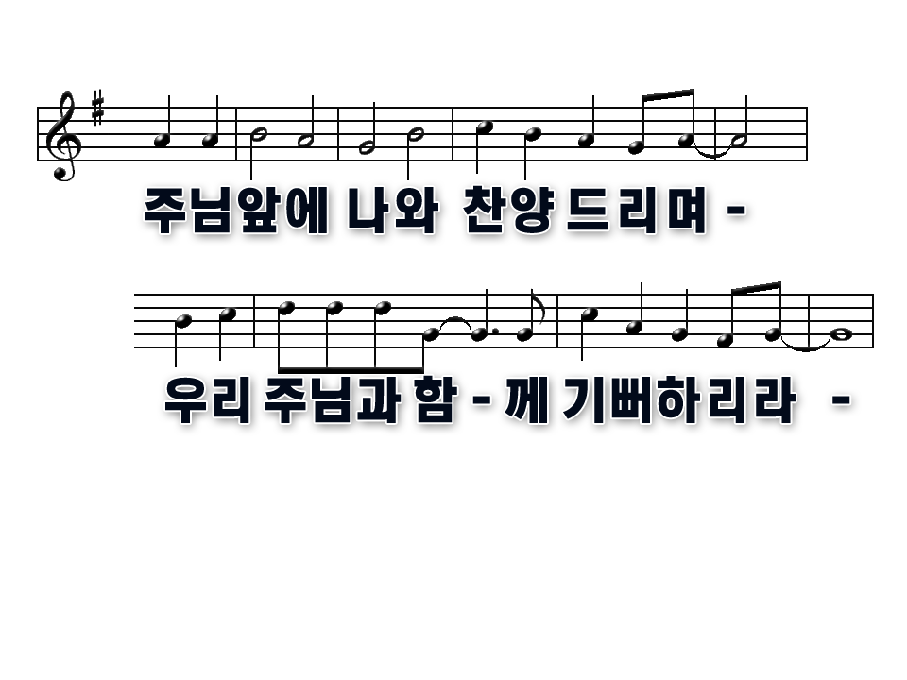
Come before His throne to worship and adore
Enter joyfully now the presence of the Lord

Slide 3
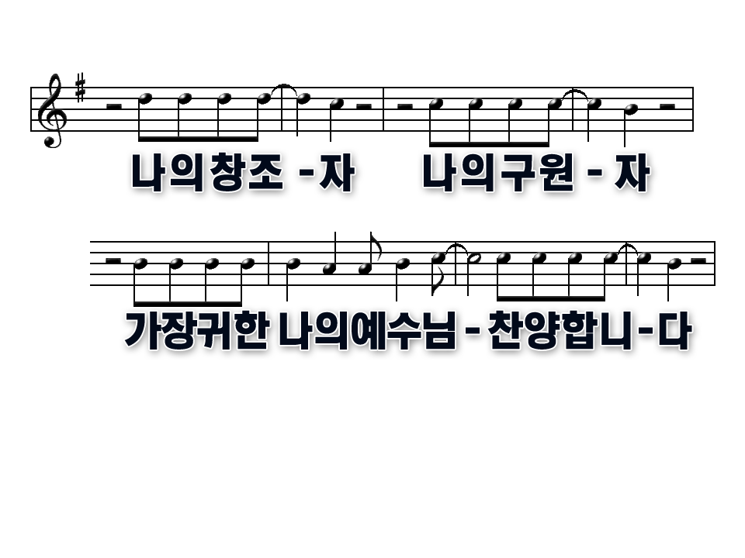
You're my Creator, You're my Deliverer
You're my Redeemer You are Lord, and You're my Healer,

Slide 4
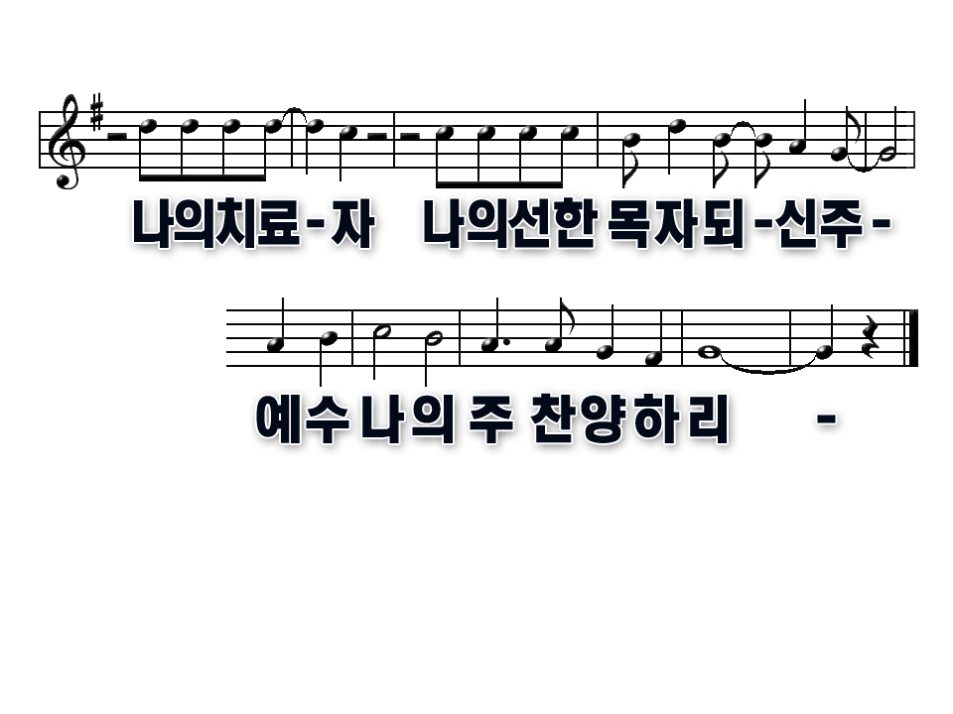
You're my Provider
You're my Shepard and my Guide
Jesus, Lord and King, I worship You

Slide 5
Shout for joy and sing your praises to the King
Lift your voice high, let your Hallelujahs ring

Slide 6
Come before His throne to worship and adore
Enter joyfully now the presence of the Lord

Slide 7
You're my Creator, You're my Deliverer
You're my Redeemer You are Lord, and You're my Healer,

Slide 8
You're my Provider
You're my Shepard and my Guide
Jesus, Lord and King, I worship You

