Slide 1
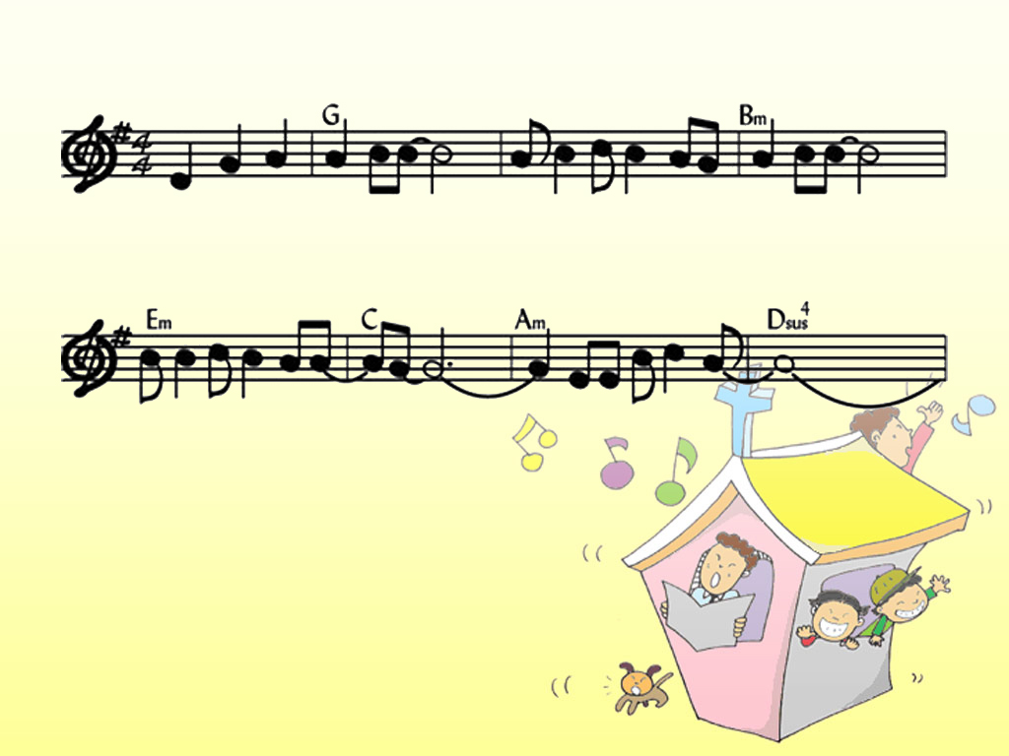
다 와서 찬양해
다와서 찬양해- 사랑을주신주 찬양해
Come on and celebrate His gift of love, We will celebrate
사랑의우리주님- - 생명주셨네 -
The Son of God who loved us And gave us life.
1-3

Slide 2
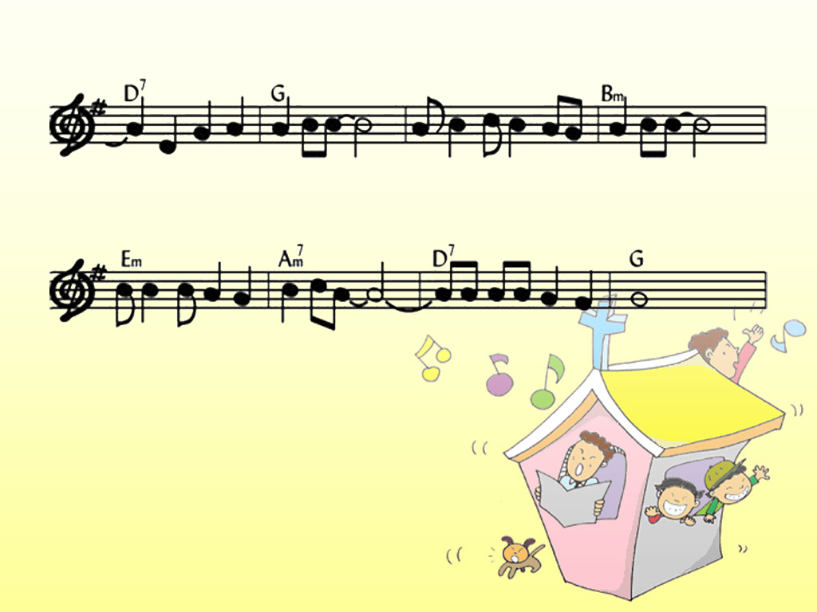
- 소리쳐 찬양해-기쁨을주시는우리왕
Come on and celebrate His gift of love, We will celebrate
찬양의제사드리며 - 주님께경배해
The Son of God who loved us And gave us life.
2-3

Slide 3
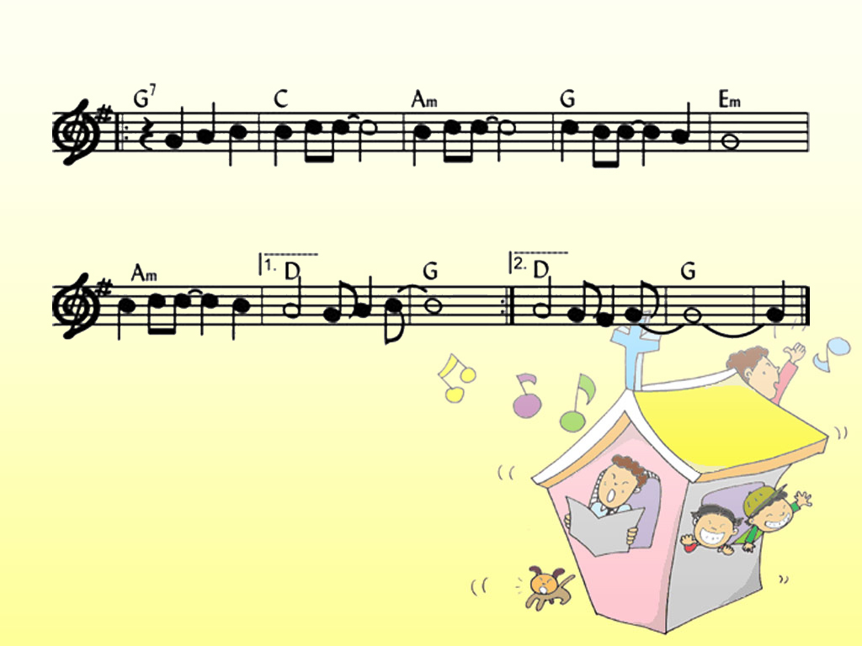
다와서찬양해 찬양해 찬양해 주님
Come on and celebrate Celebrate celebrate and sing
찬양해 주님 우리왕- 님 우리왕 - -
Celebrate and sing to the King
3-3

