Slide 1
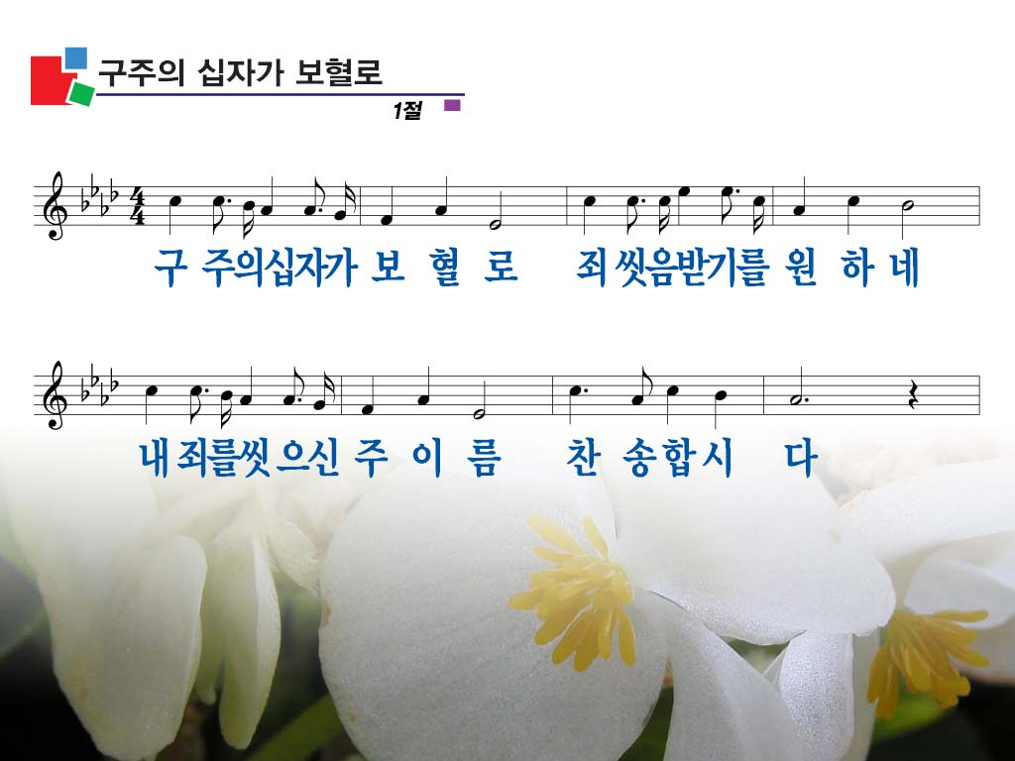
Down at the cross where my Savior died,
Down where for cleansing from sin I cried,
There to my sin was the blood applied;
Glory to His name!

Slide 2
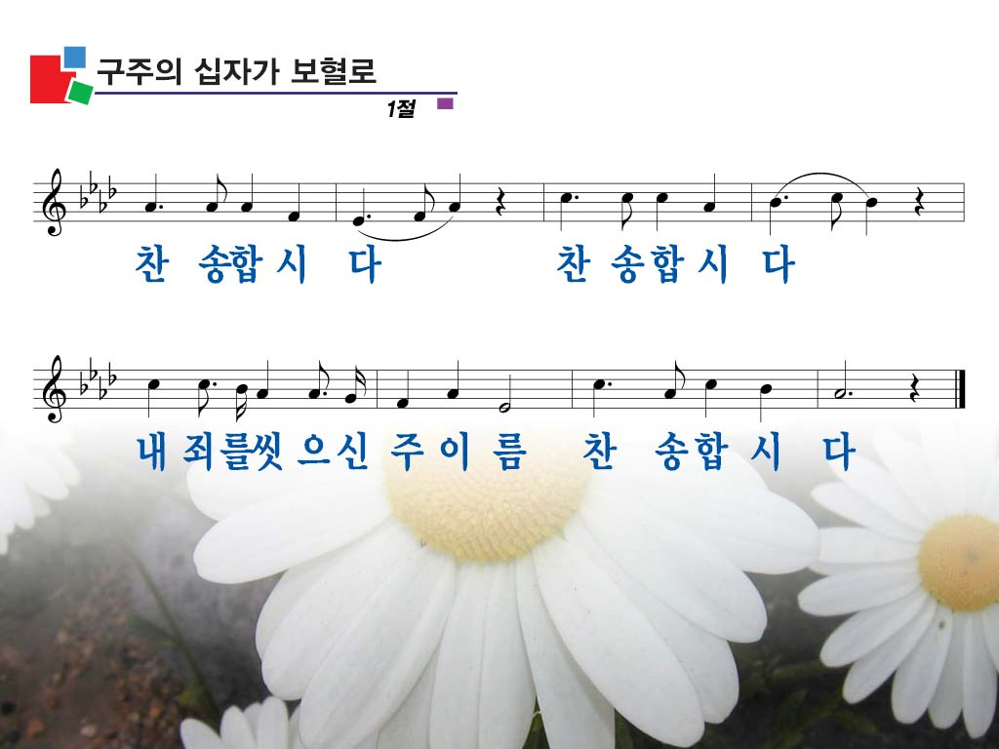
Glory to His name!
Glory to His name!
There to my sin was the blood applied;
Glory to His name!

Slide 3

I am so wondrously saved from sin,
Jesus so sweetly abides within;
There at the cross where He took me in;
Glory to His name.

Slide 4
Glory to His name!
Glory to His name!
There to my sin was the blood applied;
Glory to His name!

Slide 5

Oh, precious fountain that saves from sin,
I am so glad I have entered in;
There Jesus saves me and keeps me clean;
Glory to His name.

Slide 6

Glory to His name!
Glory to His name!
There to my sin was the blood applied;
Glory to His name!

Slide 7
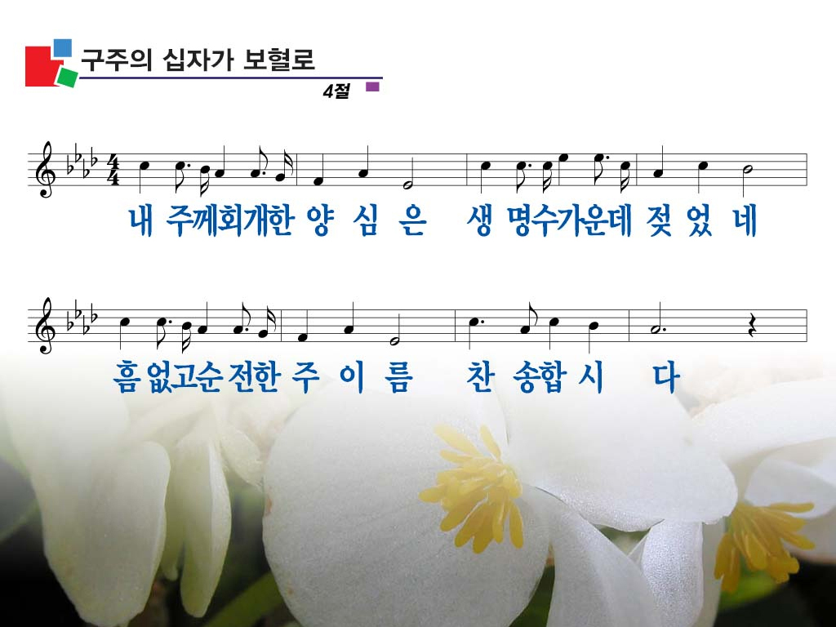
Come to this fountain so rich and sweet;
Cast thy poor soul at the Savior’s feet;
Plunge in today, and be made complete;
Glory to His name.

Slide 8

Glory to His name!
Glory to His name!
There to my sin was the blood applied;
Glory to His name!

