Slide 1
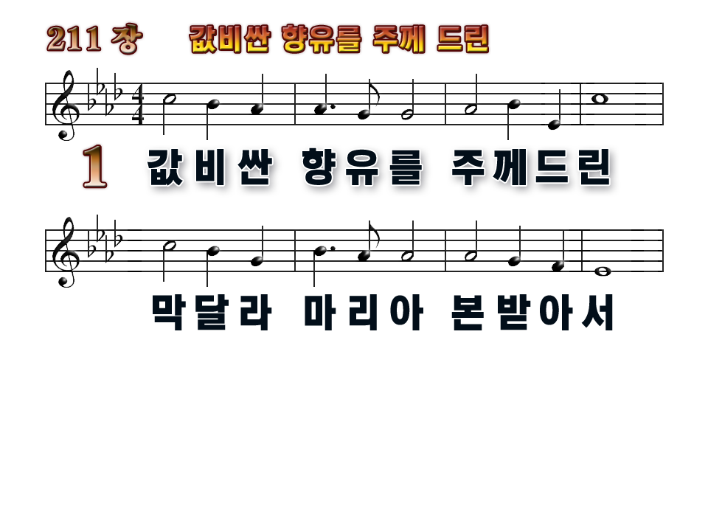

Master, no offering costly and sweet,
May we, like Magdalene, lay at Thy feet;
1
2
3
4

Slide 2
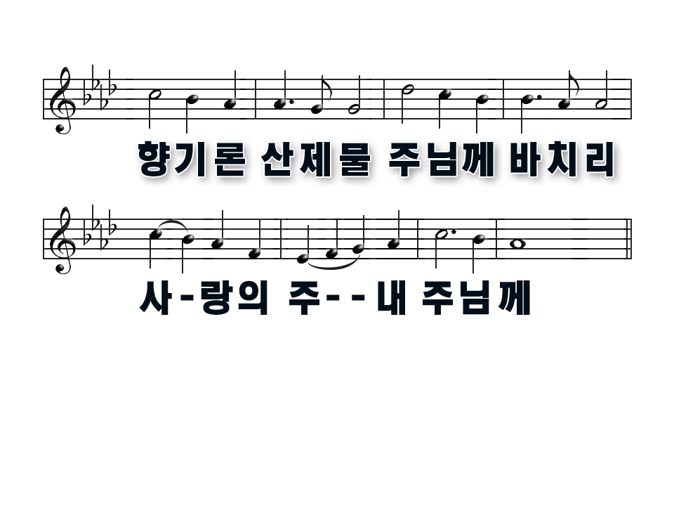
Yet may love’s incense rise, sweeter
than sacrifice,
Dear Lord to Thee, dear Lord to Thee.
1
2
3
4

Slide 3
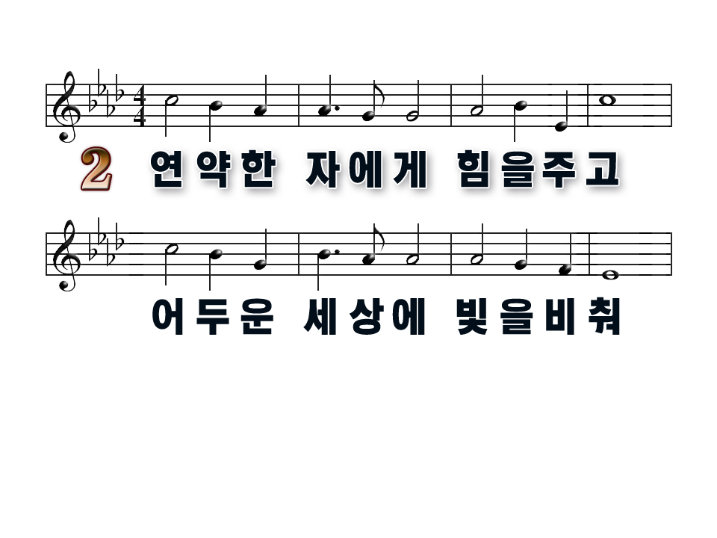
Daily our lives would show
weakness made strong,
Toilsome and gloomy ways
brightened by song
1
2
3
4

Slide 4
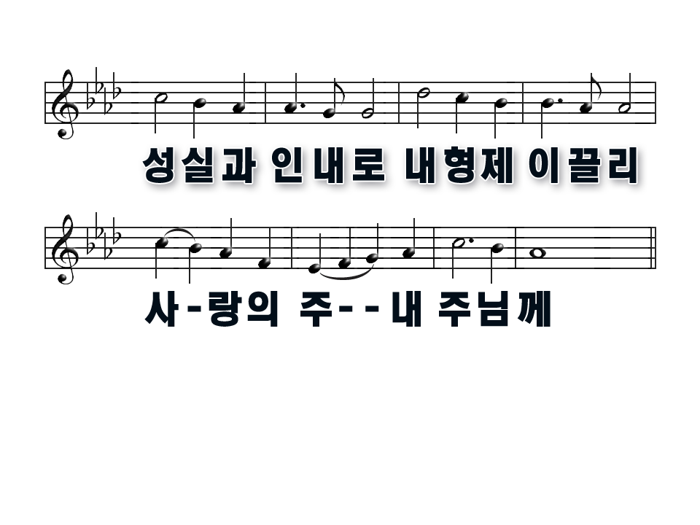
Some deeds of kindness done,
some souls by patience won,
Dear Lord to Thee, dear Lord to Thee.
1
2
3
4

Slide 5
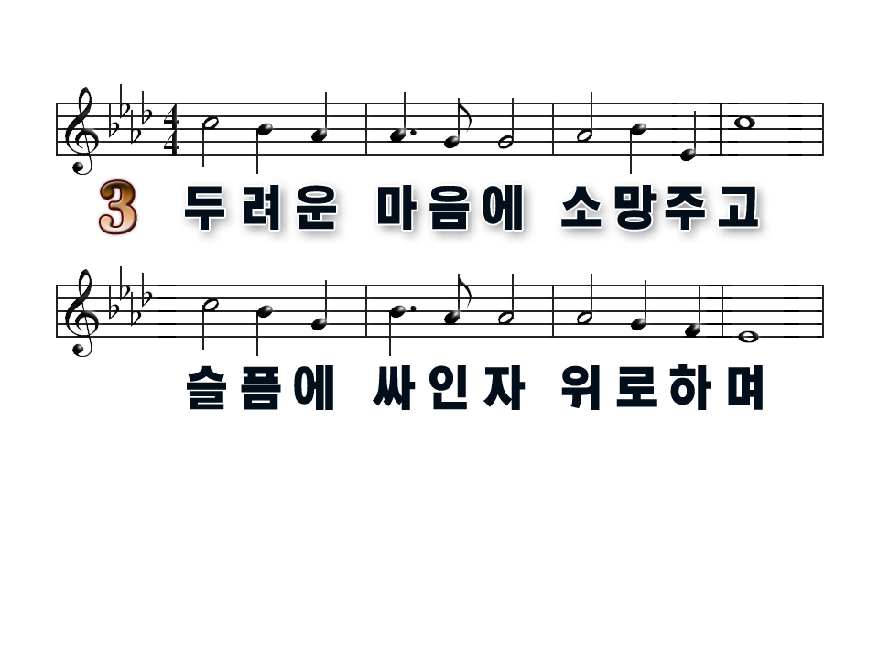
Some word of hope for hearts
burdened with fears,
Some balm of peace for eyes
blinded with tears,
1
2
3
4

Slide 6
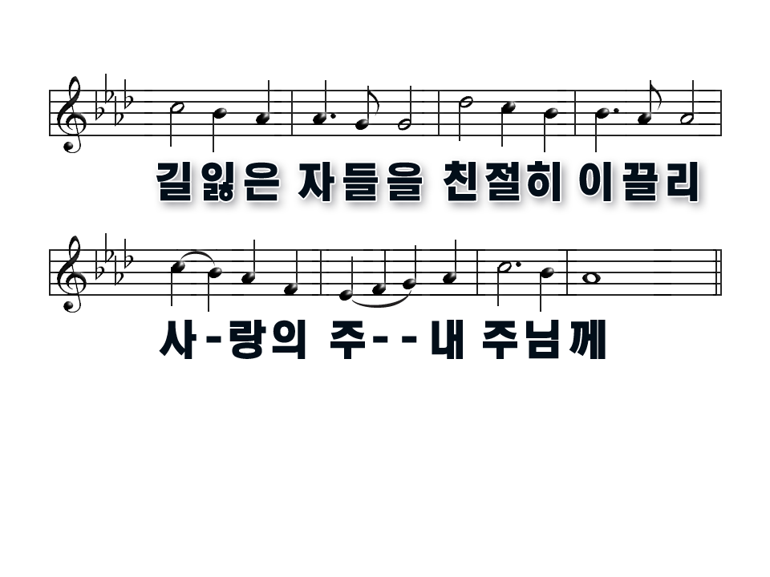
Some dews of mercy shed,
some wayward footsteps led,
Dear Lord to Thee, dear Lord to Thee
1
2
3
4

Slide 7
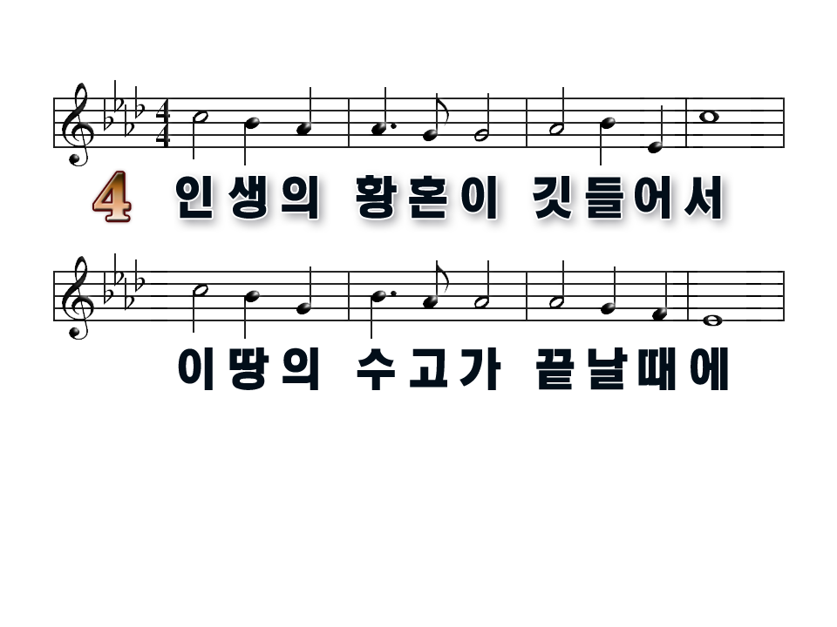
Thus, in Thy service, Lord, till eventide
Closes the day of life may we abide;
1
2
3
4

Slide 8
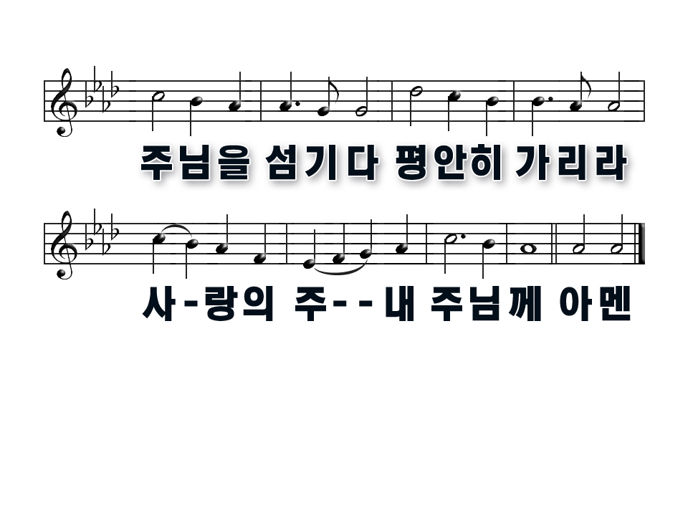
And when earth’s labors cease,
bid us depart in peace,
Dear Lord to Thee, dear Lord to Thee.
1
2
3
4

