Slide 1
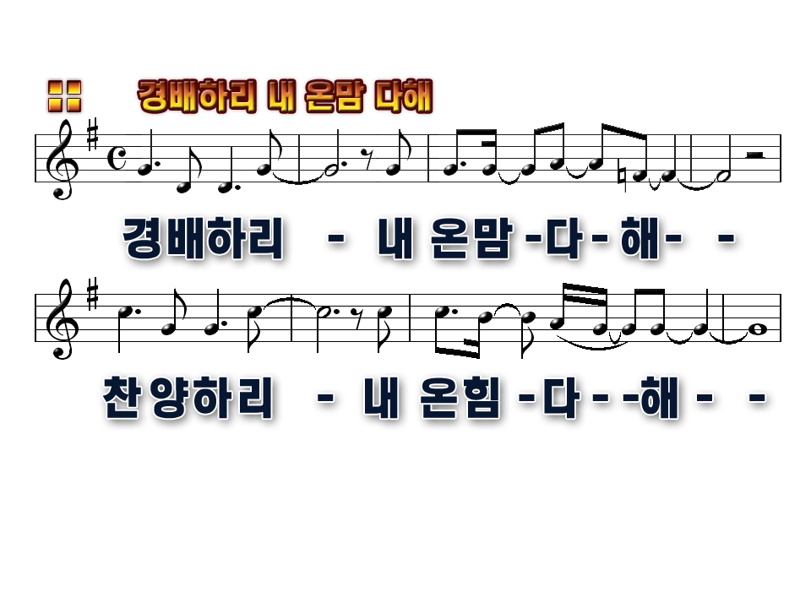
I will worship with all of my heart
I will praise you with all of my strength

Slide 2
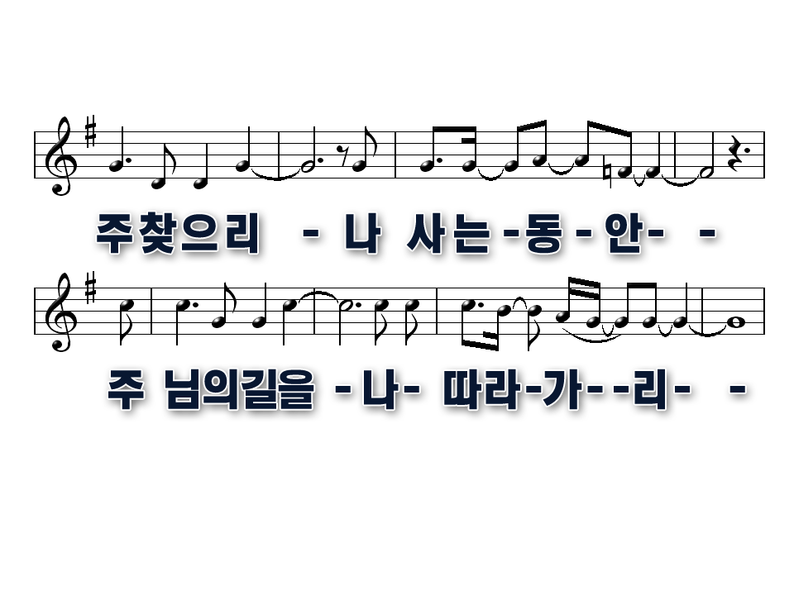
I will seek you all of my days
I will follow you all of my ways

Slide 3
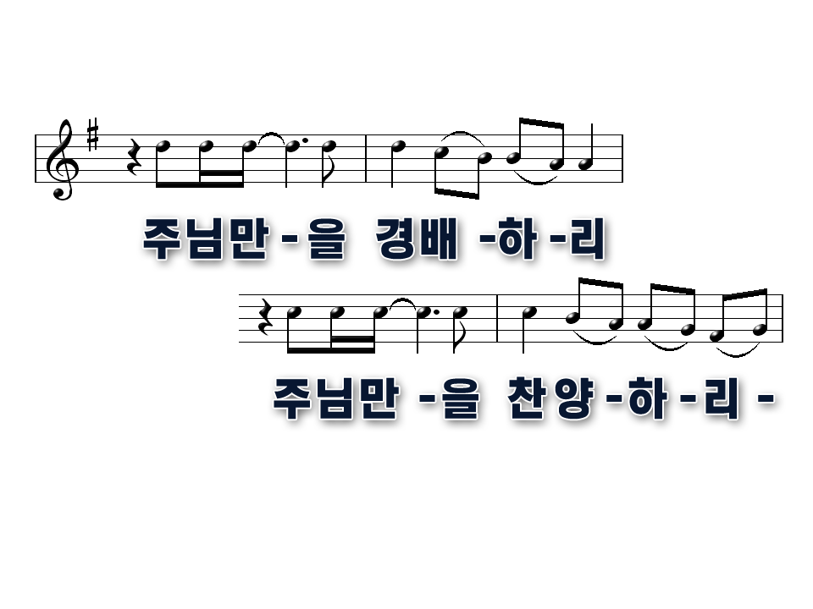
I will give you all of my worship
I will give you all of my praise

Slide 4
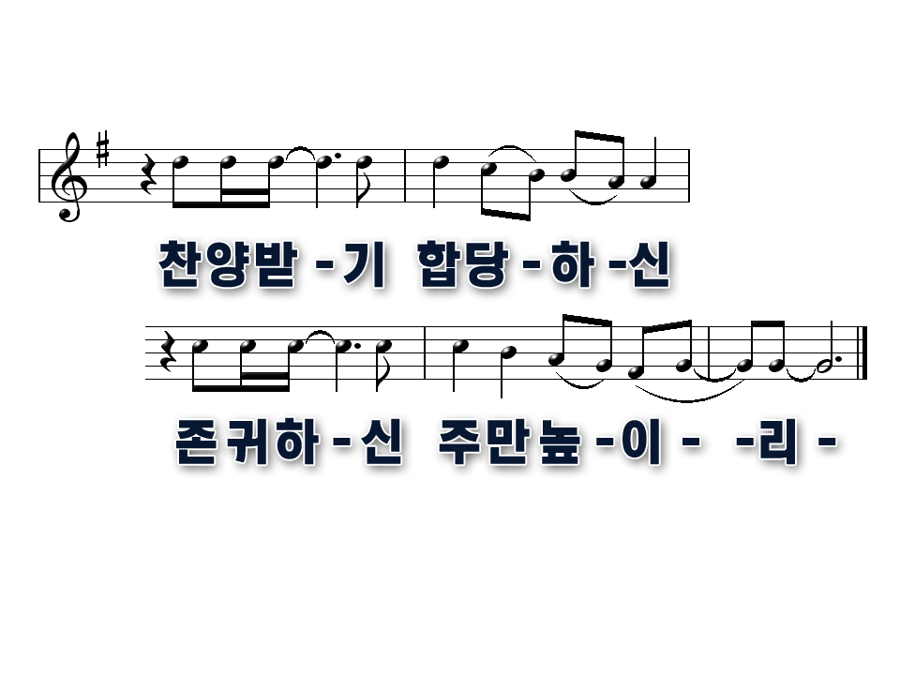
You alone I long to worship
You alone are worthy of my praise

Slide 5
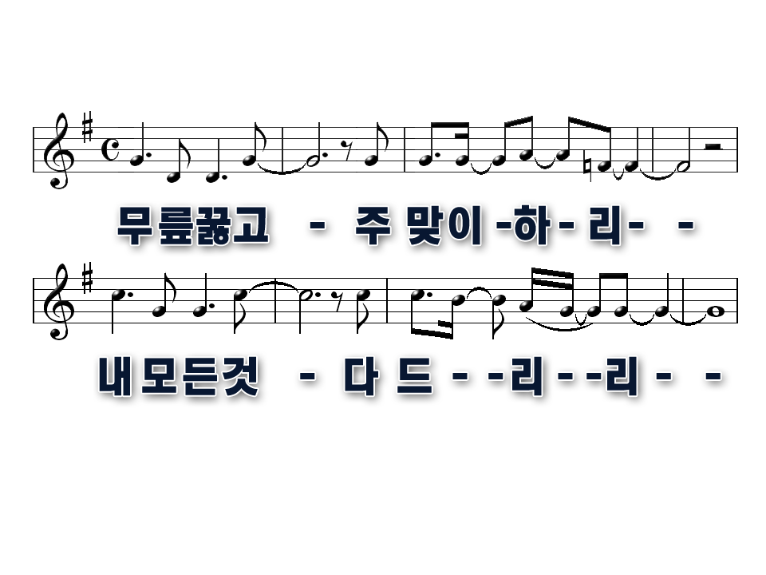
I will bow down, and I'll hail you as king
I will serve you, I will give you everything

Slide 6
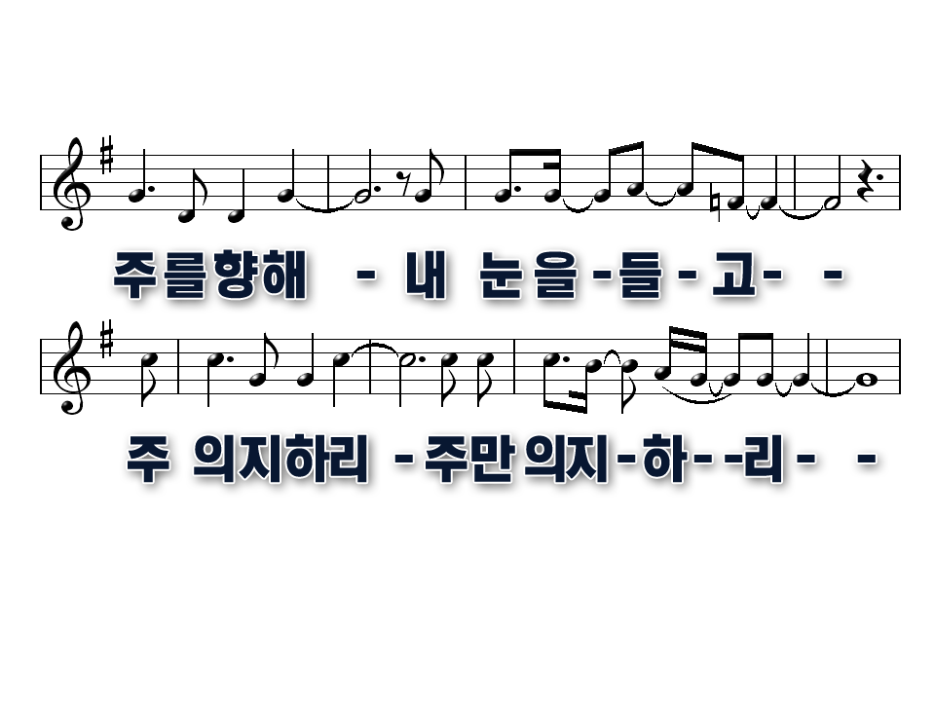
I will lift up my eyes to your throne
I will trust you, I will trust you alone

Slide 7
I will give you all of my worship
I will give you all of my praise

Slide 8
You alone I long to worship
You alone are worthy of my praise

