Slide 1
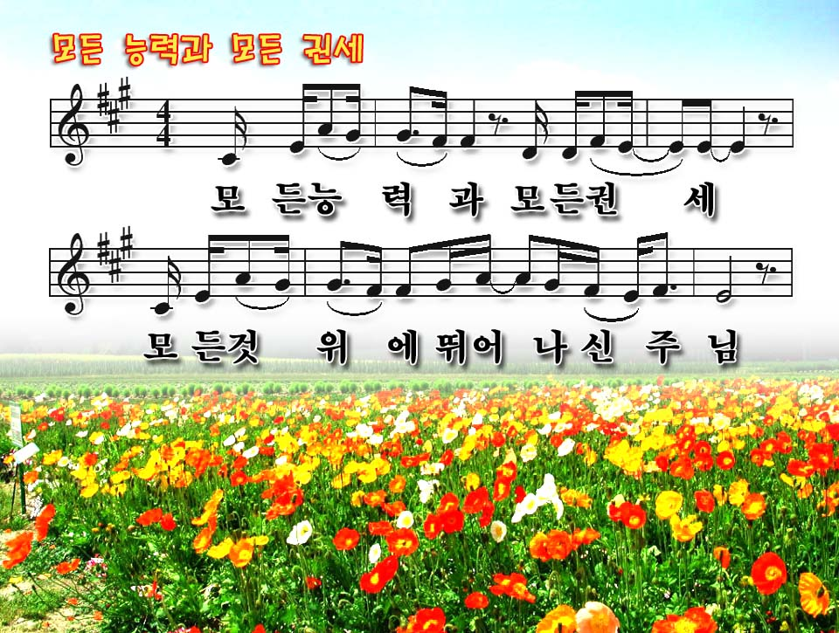
Above all powers
Above all kings
Above all nature
And all created things

Slide 2
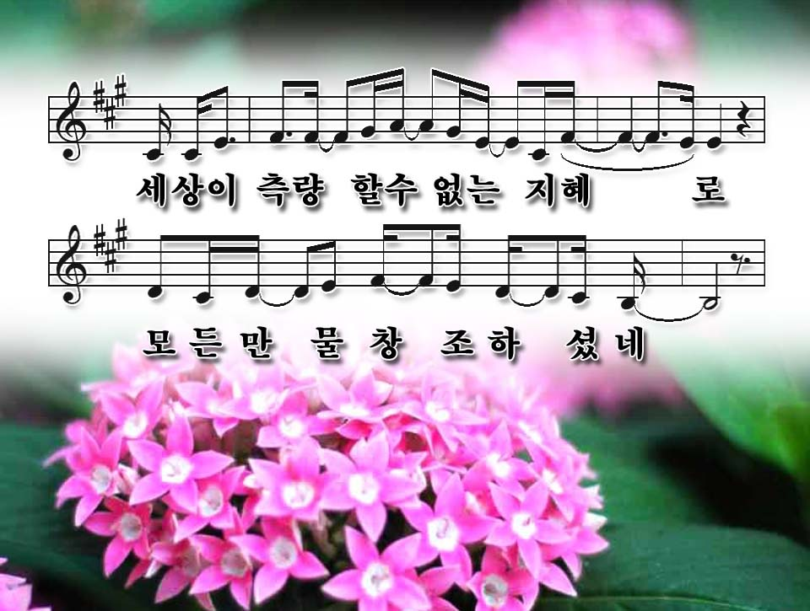
Above all wisdom
And all the ways of man
You were here
Before the world began

Slide 3
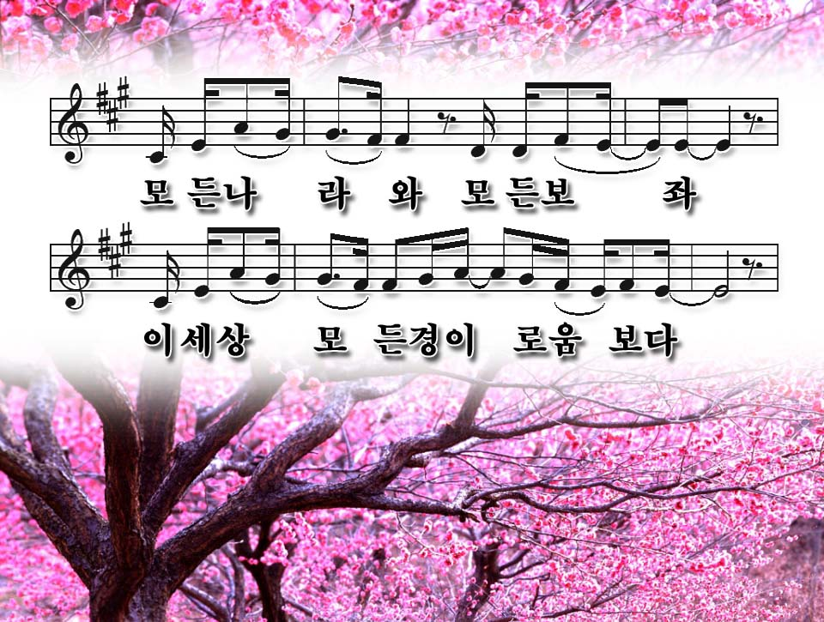
Above all kingdoms
Above all thrones
Above all wonders
The world has ever known

Slide 4
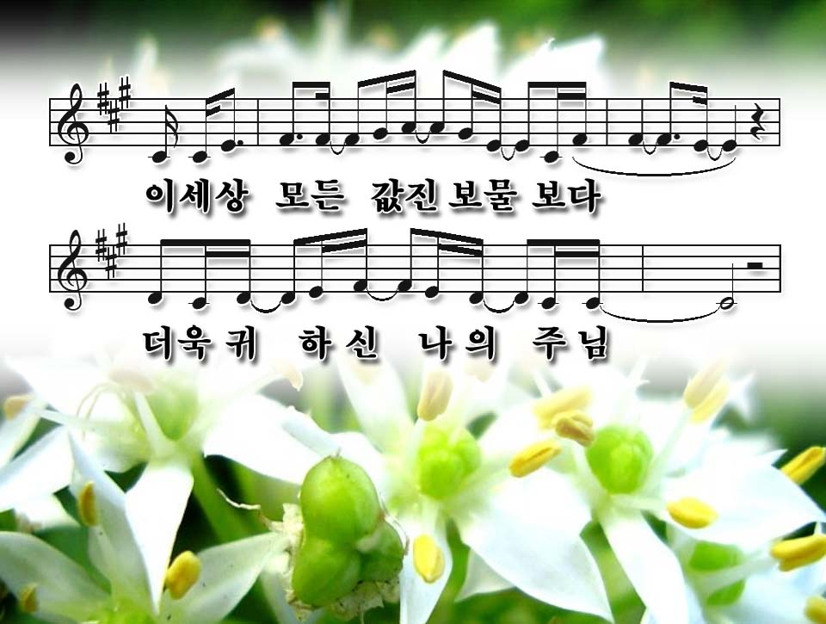
Above all wealth
And treasures of the earth
There's no way to measure
What You're worth

Slide 5
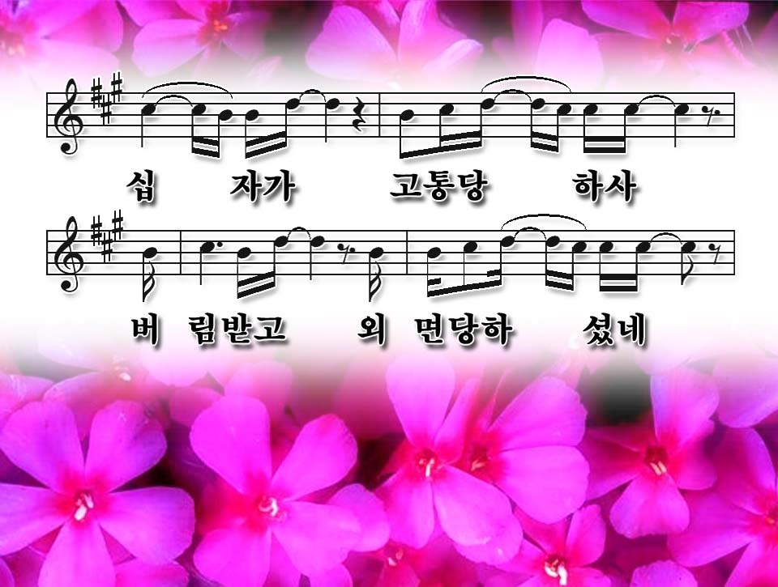
Crucified
Laid behind a stone
You lived to die
Rejected and alone

Slide 6
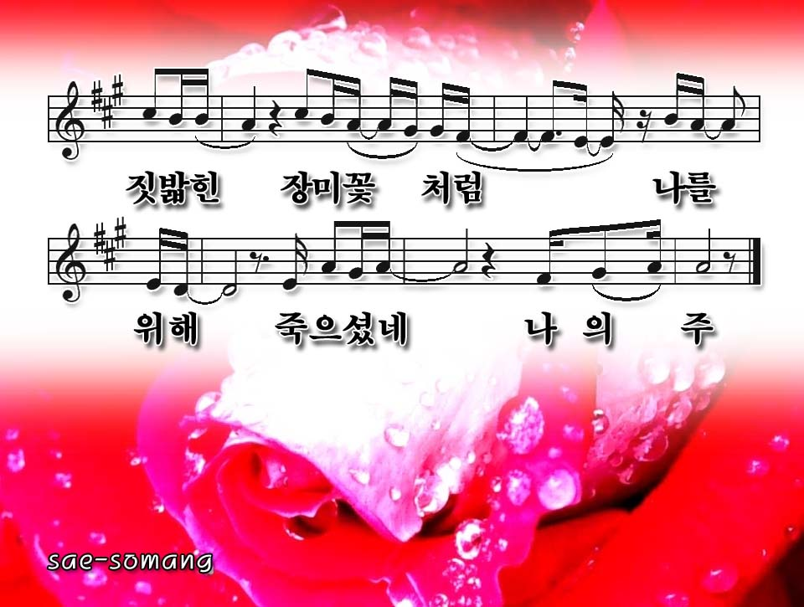
Like a rose
Trampled on the ground
You took the fall
And thought of me
Above all

Slide 7
Above all powers
Above all kings
Above all nature
And all created things

Slide 8
Above all wisdom
And all the ways of man
You were here
Before the world began

Slide 9
Above all kingdoms
Above all thrones
Above all wonders
The world has ever known

Slide 10
Above all wealth
And treasures of the earth
There's no way to measure
What You're worth

Slide 11
Crucified
Laid behind a stone
You lived to die
Rejected and alone

Slide 12
Like a rose
Trampled on the ground
You took the fall
And thought of me
Above all

