Slide 1
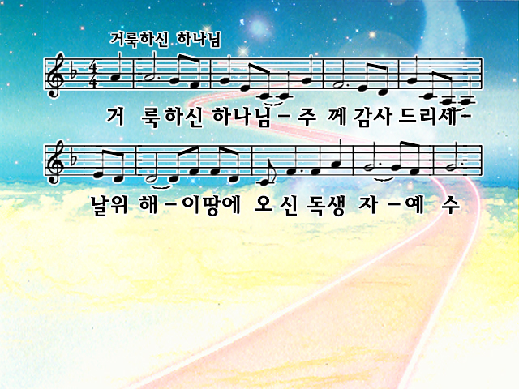
Give thanks with a grateful heart
Give thanks to the Holy One
Give thanks because He's given Jesus Christ, His Son

Slide 2
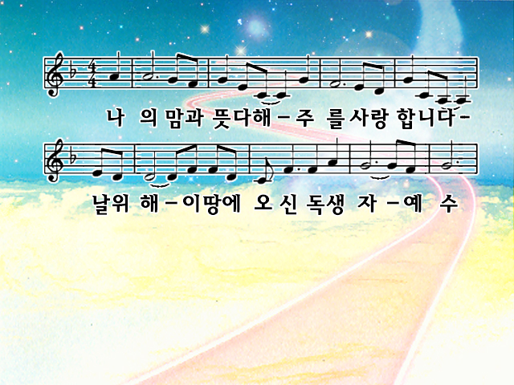
Give thanks with a grateful heart
Give thanks to the Holy One
Give thanks because He's given Jesus Christ, His Son

Slide 3
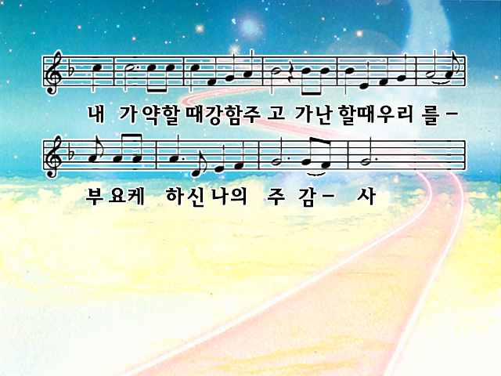
And now let the weak say, "I am strong"
Let the poor say, "I am rich
Because of what the Lord has done for us"

Slide 4
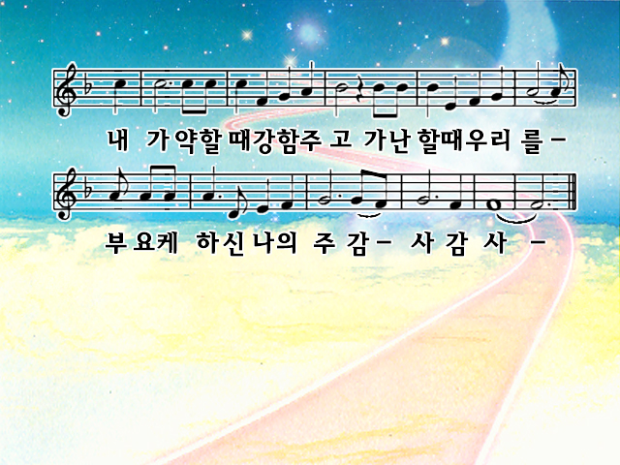
And now let the weak say, "I am strong"
Let the poor say, "I am rich
Because of what the Lord has done for us"

Slide 5
Give thanks with a grateful heart
Give thanks to the Holy One
Give thanks because He's given Jesus Christ, His Son

Slide 6
Give thanks with a grateful heart
Give thanks to the Holy One
Give thanks because He's given Jesus Christ, His Son

Slide 7
And now let the weak say, "I am strong"
Let the poor say, "I am rich
Because of what the Lord has done for us"

Slide 8
And now let the weak say, "I am strong"
Let the poor say, "I am rich
Because of what the Lord has done for us"

